Slide 1
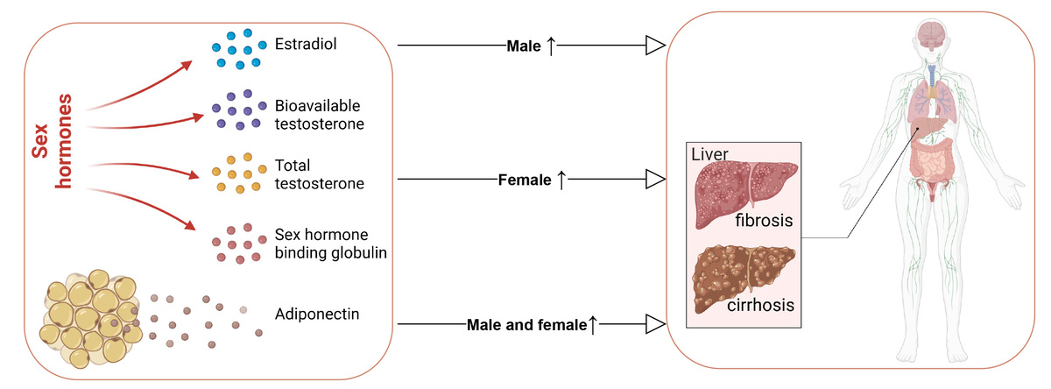

Investigating the potential impact of sex hormones and adiponectin on the risk of liver fibrosis and cirrhosis: a Mendelian randomization study
DOI: 10.5114/aoms/200596
Arch Med Sci 2025;21(6):2502-2512
Notes:
Introduction
Liver fibrosis is a reversible wound-healing response to acute or chronic liver injury. Liver cirrhosis is the advanced stage of liver fibrosis. This study explored the causal associations of sex hormones – estradiol, bioavailable testosterone, total testosterone, and sex hormone-binding globulin (SHBG) – and adiponectin with liver fibrosis, cirrhosis, and primary biliary cirrhosis (PBC).
Material and methods
A two-sample Mendelian randomization (MR) study using publicly available data was performed. Causal estimates were calculated by the inverse variance weighted (IVW) method, and additional approaches such as MR-Egger, weighted median, simple mode, and weighted mode were used to complement the IVW approach. Sensitivity analysis was performed employing leave-one-out analysis.
Results
The IVW analysis revealed a relationship between genetically predicted total testosterone levels and the likelihood of fibrosis and cirrhosis in females; odds ratio (OR) = 1.537, 95% confidence interval (CI): 1.082–2.182. There was a significant association between genetically predicted estradiol levels and an increased risk of liver fibrosis and cirrhosis (OR = 2.287, 95% CI: 1.403–3.727) and PBC (OR = 3.075, 95%CI: 1.306–7.240) in males. Our findings indicated that genetically predicted adiponectin was causally related to fibrosis and cirrhosis (OR = 1.608, 95% CI: 1.063–2.430) and PBC (OR = 2.631, 95% CI: 1.211–5.715). MR-Egger, weighted median, simple mode and weighted mode consistently yielded similar outcomes. Cochrane’s Q test showed no heterogeneity in these instrumental variables, and there was no significant directional pleiotropy.
Conclusions
There were positive causal associations of total testosterone with fibrosis and cirrhosis among females, and of estradiol levels with liver fibrosis and cirrhosis and PBC in males. Higher adiponectin could increase the risk of fibrosis and cirrhosis and PBC.

