Slide 1
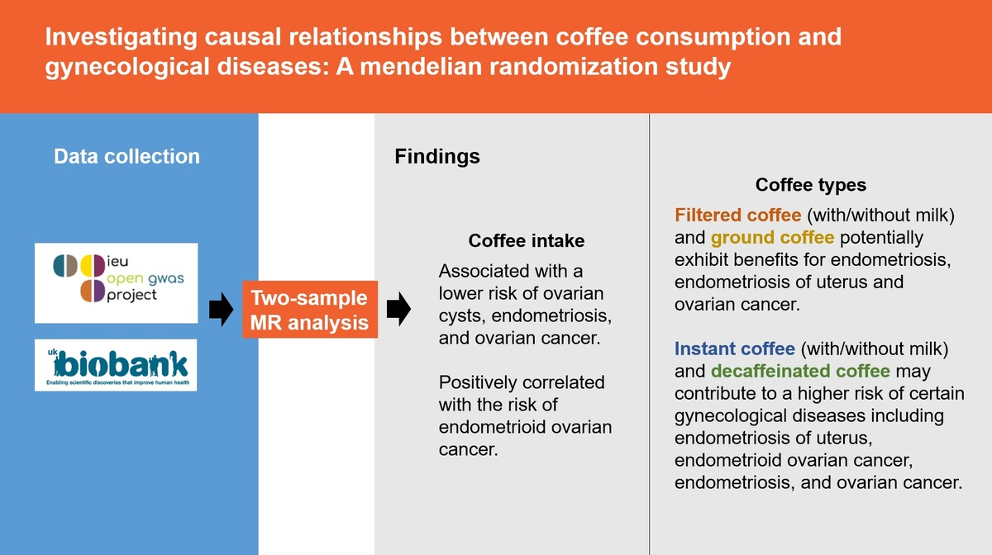

Investigating causal relationships between coffee consumption and gynecological diseases: a Mendelian randomization study
DOI: 10.5114/aoms/200788
Notes:
Introduction
Gynecological diseases, including infections, endocrine disorders, and tumors, significantly impact women’s quality of life. Emerging evidence suggests that metabolic factors, nutrition, and dietary habits, such as coffee consumption, may influence these conditions. This study employed two-sample Mendelian randomization (2SMR) to investigate the relationship between coffee intake and gynecological diseases.
Material and methods
Publicly available genome-wide association study (GWAS) data from the Integrative Epidemiology Unit (IEU) GWAS database were analyzed using the TwoSampleMR R package. Data on coffee consumption were extracted from the UK Biobank. Instrumental variables were selected based on p < 5 × 10–8 and F-statistic > 10, and causal relationships were assessed using inverse variance weighting (IVW) and the Wald ratio (WR) method. Heterogeneity and pleiotropy were tested using MR-Egger regression. A negative control analysis using skin color was performed to address confounding by population stratification.
Results
The 2SMR analysis identified significant associations between coffee intake and reduced risks of ovarian cancer (OR = 0.07, 95% CI: 0.01–0.84), ovarian cyst (OR = 0.68, 95% CI: 0.49–0.95), and endometriosis (OR = 0.99, 95% CI: 0.99–1.00). Conversely, increased risks were noted for endometrioid ovarian cancer (OR = 7.88, 95% CI: 1.05–59.22). Analysis of different coffee types revealed that ground coffee was associated with decreased risks of ovarian cancer and endometriosis, while decaffeinated coffee showed positive associations with ovarian cancer and endometriosis.
Conclusions
Coffee intake, especially ground coffee, may lower the risk of certain gynecological diseases. However, decaffeinated coffee may increase these risks. Further research is needed to understand the mechanisms behind these findings.

