Slide 1
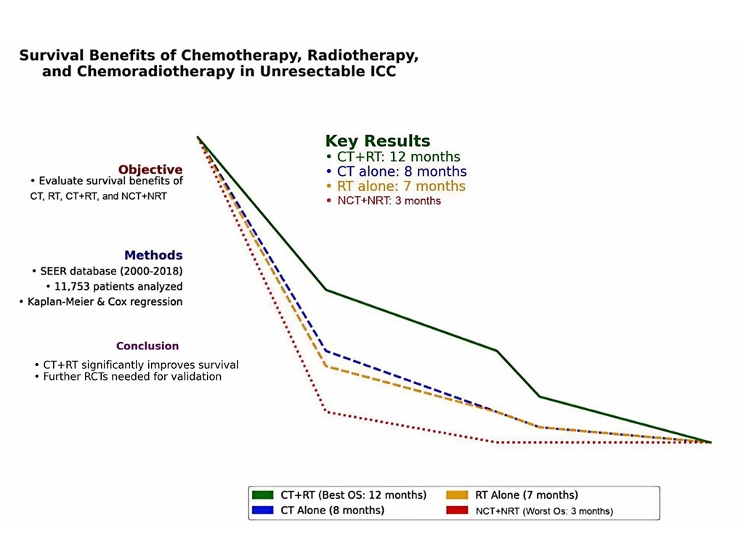

Survival benefits of chemotherapy, radiotherapy, and chemoradiotherapy in patients with unresectable intrahepatic cholangiocarcinoma: a population-based study
DOI: 10.5114/aoms/200997
Arch Med Sci 2026;22(1):114-124
Notes:
Introduction
This population-based study aimed to evaluate the survival benefits of radiotherapy, chemotherapy, chemoradiotherapy, and non-chemoradiotherapy in patients with unresectable intrahepatic cholangiocarcinoma (ICC).
Material and methods
We used the Surveillance, Epidemiology, and End Results (SEER) database’s SEER*stat software (version 8.3.5) to gather data of patients diagnosed with unresectable ICC from 2000 to 2018. Survival curves were plotted using the Kaplan-Meier method, comparing the overall survival (OS) and cancer-specific survival (CSS) among patients who underwent radiotherapy, chemotherapy, chemoradiotherapy, or no therapy at all. Univariate and multivariate Cox regression models were employed to analyze the prognostic factors affecting these unresectable ICC patients.
Results
From 2000 to 2018, we identified 11,753 cases of unresectable ICC from the SEER database. Of these, 4,531 (38.5%) patients underwent chemotherapy alone, 482 (4.1%) patients underwent radiotherapy alone, and 996 (8.5%) patients received a combination of both. A total of 5,744 (48.9%) patients did not receive chemoradiotherapy. The median OS was 8 months (95% CI: 8–-9 months) for patients receiving chemotherapy alone, 7 months (95% CI: 6–8 months) for radiotherapy alone, 12 months (95% CI: 11–13 months) for chemoradiotherapy, and 3 months (95% CI: 3–3 months) for those not receiving chemoradiotherapy. The CSS findings were consistent with the OS results. The Cox regression models indicated that patient age, sex, grade classification, tumor diameter, and treatment modality were independent prognostic factors for unresectable ICC patients (p < 0.05).
Conclusions
Chemoradiotherapy can enhance the OS and CSS of patients with unresectable ICC, compared to the use of chemotherapy or radiotherapy alone.

