Slide 1
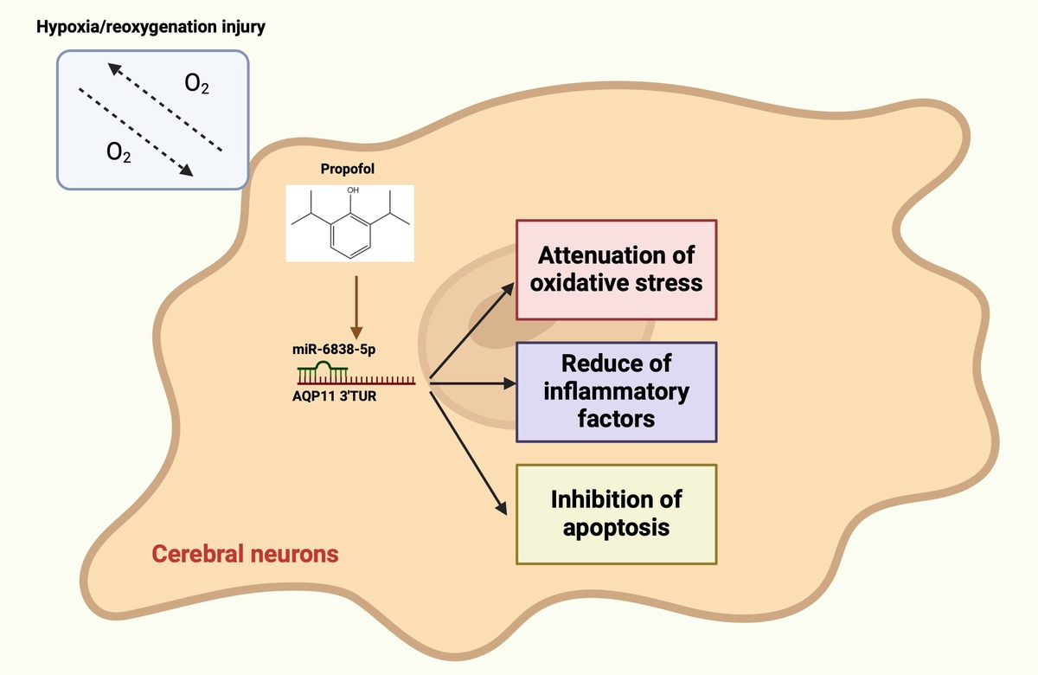

Propofol attenuates cerebral ischemia–reperfusion-mediated neuronal apoptosis and oxidative damage by regulating the miR-6838-5p/AQP11 axis
DOI: 10.5114/aoms/201185
Arch Med Sci 2026;22(2):1183-1205
Notes:
Introduction
This study aimed to elucidate the mechanism by which propofol (PPF) exerts its effects in cerebral ischemia–reperfusion injury (CI/RI).
Material and methods
A rat model of CI/RI was established via middle cerebral artery occlusion/reperfusion (MCAO/R). MCAO/R rats were pre-treated with PPF (10 mg/kg) via intraperitoneal injection. Additionally, 48 h before PPF administration, miR-6838-5p agomir/antagomir and aquaporin-11 (AQP11) lentiviral overexpression vectors were injected into MCAO/R rats. Infarct size was determined using 2,3,5-triphenyl tetrazolium chloride staining. Neurological function was assessed using standardized scoring, and cerebral edema was measured by determining brain water content. Hematoxylin-eosin staining, Nissl staining, and terminal deoxynucleotidyl transferase dUTP nick end labeling staining were performed on brain tissues. Inflammatory and oxidative markers were evaluated. A hypoxia/reoxygenation (H/R) injury model was established in PC12 cells to assess miR-6838-5p and AQP11 expression levels, as well as cell viability and apoptosis.
Results
The lethal dose 50 (LD50) of PPF in rats was determined to be 22.6 mg/kg, significantly higher than the therapeutic dose. PPF or overexpression of miR-6838-5p resulted in reduced cerebral infarct size, neuronal necrosis, and apoptosis, increased Nissl bodies, and decreased brain edema, apoptosis, tumor necrosis factor-a, interleukin-1b, and malondialdehyde (MDA) levels. Glutathione peroxidase (GSH-Px) and superoxide dismutase (SOD) activities were elevated in MCAO/R rats treated with PPF. These protective effects of PPF were reversed by miR-6838-5p knockdown or AQP11 overexpression. PPF ameliorated H/R-induced neuronal damage, enhanced neuronal activity, reduced apoptosis and MDA production, and increased GSH-Px and SOD levels.
Conclusions
PPF ameliorates CI/RI by modulating the miR-6838-5p/AQP11 axis.

