Slide 1
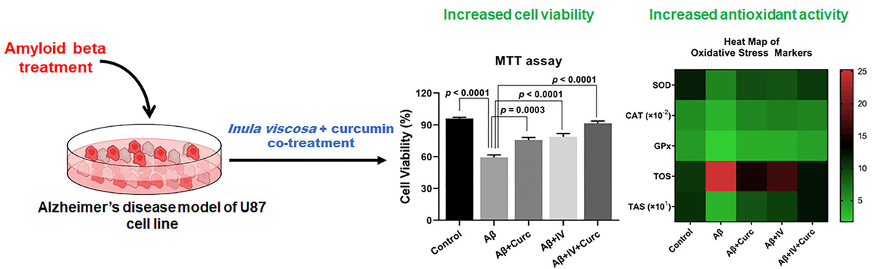

Enhanced neuroprotection against Alzheimer’s disease by combining <i>Inula viscosa</i> with curcumin: an <i>in vitro</i> study
DOI: 10.5114/aoms/201186
Notes:
Introduction
Alzheimer’s disease (AD), the most prevalent type of dementia among older individuals, is characterized by severe neurodegeneration with symptoms of progressive loss of cognitive capacity. We aimed to investigate the effects of curcumin (Curc) and Inula viscosa (IV) plant extracts on apoptosis and oxidative stress in an amyloid-β (Aβ<i></i>)-induced in vitro AD model.
Material and methods
The human glioblastoma cell line (U87) was treated with Aβ to produce an in vitro AD model. Treatment groups were: Aβ + Curc, Aβ + IV, and Aβ + IV + Curc. Cell viability assay was performed to analyze cytotoxicity. Caspase-3 (CASP3) levels were measured to evaluate apoptosis. For oxidative stress, glutathione peroxidase (GPx), catalase (CAT), superoxide dismutase (SOD), total antioxidant (TAS), and total oxidant (TOS) levels were analyzed spectrophotometrically.
Results
Combinatory application of IV and Curc post-Aβ treatment increased cell viability of U87 cells. Aβ-upregulated CASP3 levels were markedly reduced upon IV and Curc co-treatment. Anti-oxidant parameters, i.e., SOD, CAT, GPx, and TAS levels, were significantly elevated in the IV + Curc-treated group compared to the Aβ group. The elevated TOS level after Aβ exposure returned to its basal level upon Curc + IV co-treatment.
Conclusions
IV + Curc co-treatment reduced apoptosis-related neurodegeneration and supported antioxidant activity in an Aβ-induced AD model of U87 cells. IV and Curc co-treatment can be a promising therapeutic strategy against AD.

