Slide 1
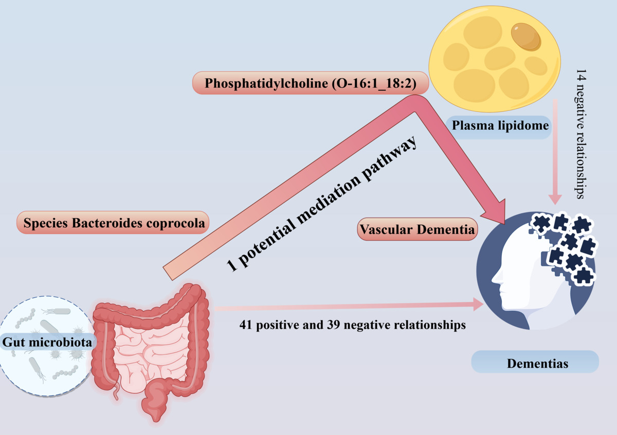

Exploring the mediating role of the plasma lipidome in the pathway from the gut microbiota to dementia: a Mendelian randomization study
DOI: 10.5114/aoms/201447
Arch Med Sci 2025;21(3):964-973
Notes:
Introduction
Previous studies have indicated a potential association between the gut microbiota (GM) and dementia; however, the exact cause-and-effect relationships between GM, various types of dementia, and the potential influence of the plasma lipidome as intermediaries are still unclear.
Material and methods
We used genome-wide association study (GWAS) data to identify GM taxa, plasma lipid species (lipidome), and five types of dementia: Alzheimer’s disease (AD), dementia with Lewy bodies (DLB), Parkinson’s disease dementia (PDD), frontotemporal dementia (FTD) and vascular dementia (VD). We used Mendelian randomization (MR) to investigate the possible causal connections among the GM, plasma lipidome, and dementias. The inverse variance weighting (IVW) method served as the primary statistical approach. We investigated the role of plasma lipidome as a potential mediating factor in this relationship.
Results
A total of 41 positive and 39 negative causal relationships between genetic susceptibility in the GM taxa or bacterial pathways and dementia, as well as 14 negative causal relationships between the plasma lipidome and dementias, were identified. Additionally, only 1 potential mediation pathway was identified as having a significant mediating effect.
Conclusions
Our results suggest a link between the GM and the plasma lipidome with five distinct types of dementia, indicating that the phosphatidylcholine (O-16:1_18:2) level could play a role in the pathway from the species <i>Bacteroides coprocola</i> to vascular dementia.

