Slide 1
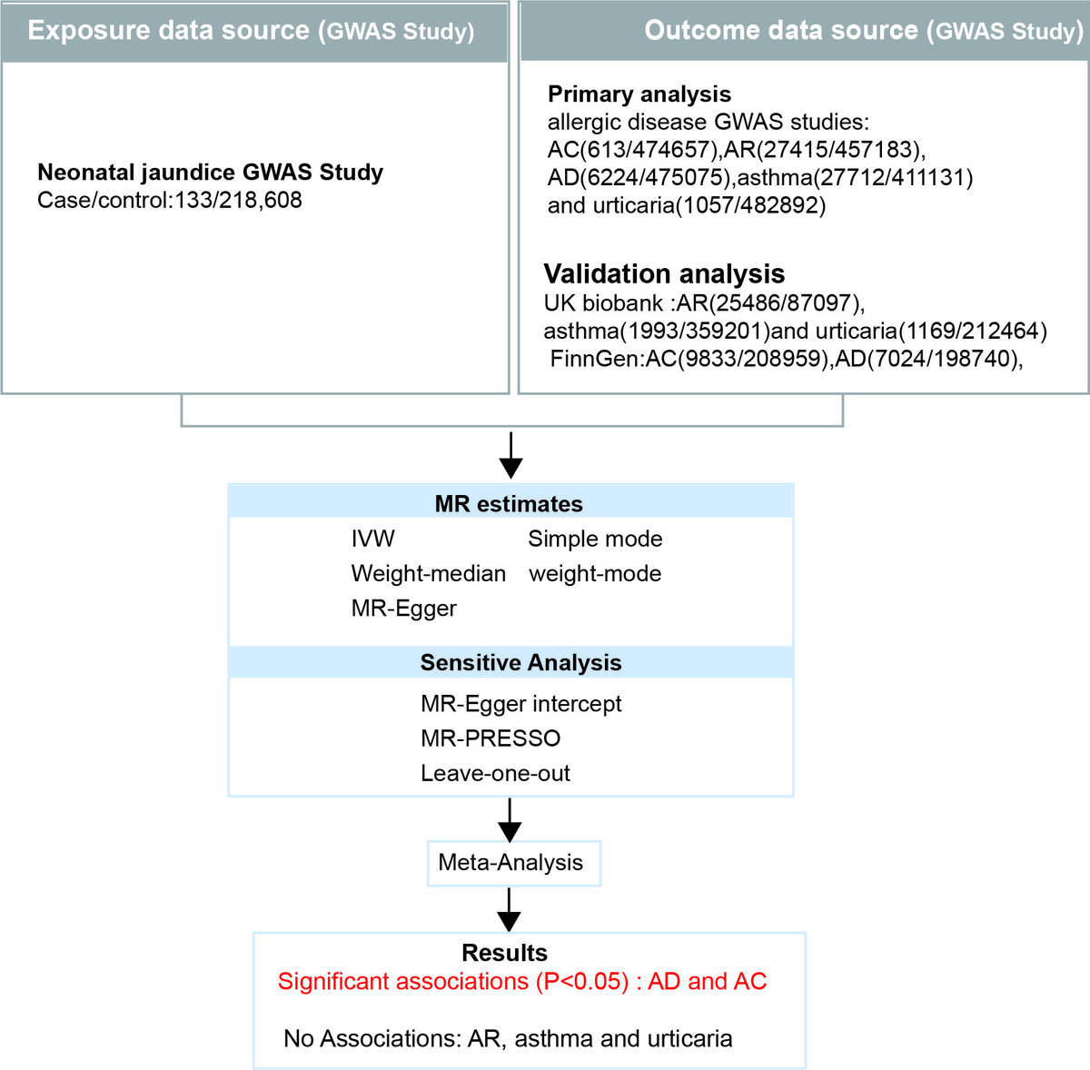

Unraveling the impact of neonatal jaundice on allergic diseases: a Mendelian randomization study
DOI: 10.5114/aoms/201976
Arch Med Sci 2026;22(1):230-240
Notes:
Introduction
Neonatal jaundice, a condition characterized by elevated bilirubin levels in newborns, is prevalent, affecting up to 60% of term infants. Previous observational studies have linked neonatal jaundice to an enhanced risk of allergic diseases such as asthma, atopic dermatitis (AD), allergic conjunctivitis (AC), allergic rhinitis (AR), and urticaria. However, the causal relationship remains unclear due to potential confounding factors and reverse causality.
Material and methods
We conducted a two-sample MR analysis using genetic variants as instrumental variables. Data from large-scale GWAS in European populations were used, including exposure data for neonatal jaundice and outcome data for five common allergic diseases. MR analysis was performed using the inverse variance weighted (IVW) method, with additional sensitivity analyses conducted using MR-Egger regression, weighted median, simple mode, and weighted mode methods.
Results
MR analysis revealed a significant causal association between neonatal jaundice and an increased risk of AD (OR = 1.0141, 95% CI: 1.0041–1.0241, p = 0.006) and AC (OR = 1.0119, 95% CI: 1.0014–1.0226, p = 0.026). No significant association was found between neonatal jaundice and pediatric asthma, urticaria, or AR. Sensitivity analyses indicated no evidence of pleiotropy, and no individual SNPs substantially influenced the results, confirming the robustness of our findings.
Conclusions
This study provides evidence for a causal association between neonatal jaundice and an increased risk of AD and AC. These findings suggest that neonatal jaundice may be a modifiable risk factor for AD and AC, highlighting the importance of neonatal jaundice management and further research on potential preventive strategies.

