Slide 1
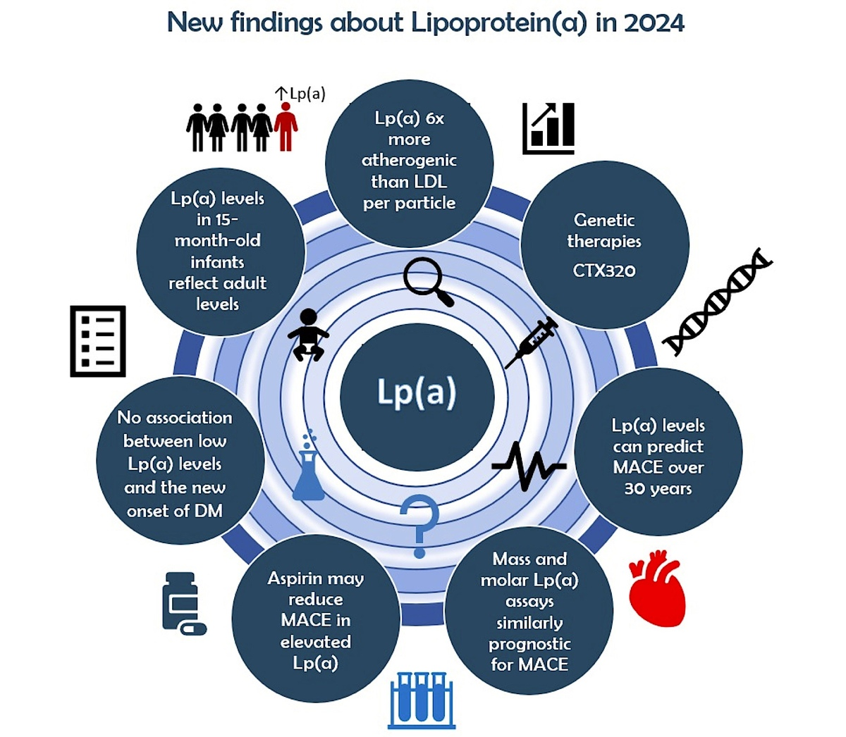

2024: The Year in Cardiovascular Disease - The Year of Lipoprotein(a) – Research Advances and New Findings.
DOI: 10.5114/aoms/202213
Arch Med Sci 2025;21(2):355-373
Notes:
Elevated plasma lipoprotein(a) [Lp(a)] levels, which occur in as many as 1.5 billion people worldwide, are an independent and causal risk factor for atherosclerotic cardiovascular disease and calcific aortic valve disease. Unlike low-density lipoprotein cholesterol, Lp(a) levels are approximately 70–90% genetically determined. Currently, no approved pharmacological therapies specifically target lowering Lp(a) concentrations. Several drugs, mainly RNA-based therapies, that specifically and potently lower Lp(a), are under investigation. Three of these new therapeutic agents are advancing through clinical development to evaluate whether reducing Lp(a) levels can decrease cardiovascular risk. The outcomes of these trials could potentially transform cardiovascular disease prevention strategies; however, once approved, the drugs will likely be used for secondary prevention, and ongoing strategies for managing elevated Lp(a) in primary prevention will be important. Lipoprotein(a) research is a rapidly evolving field, but unanswered questions remain concerning the physiological function of Lp(a) and its true pathogenic mechanisms. This review of Lp(a) research focuses on new findings and clinical trial results that appeared in 2024.

