Slide 1
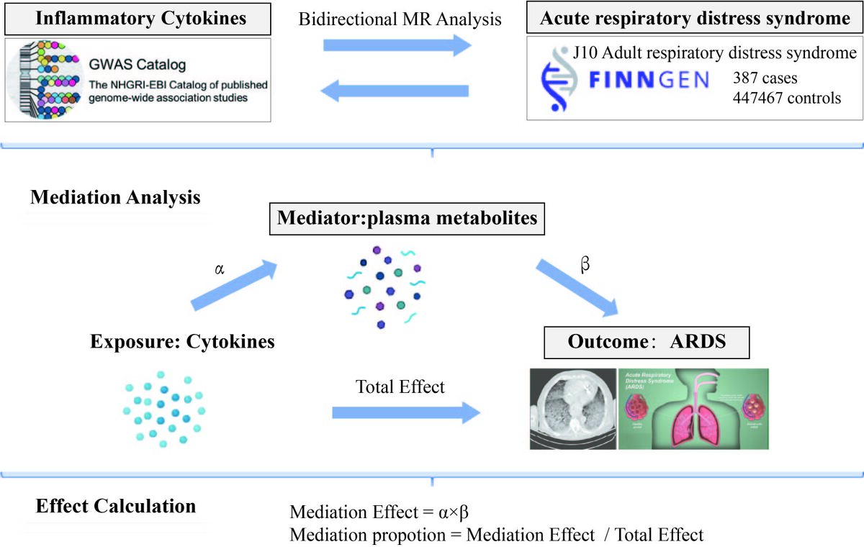

The plasma metabolite-mediated relationship between inflammatory cytokines and acute respiratory distress syndrome
DOI: 10.5114/aoms/202217
Arch Med Sci 2026;22(2):1130-1140
Notes:
Introduction
Biomarkers of acute respiratory distress syndrome (ARDS) can provide precise treatment options. ARDS is a clinical syndrome characterized by diffuse lung inflammation and edema, often leading to acute respiratory failure. We used Mendelian randomization (MR) and mediation analysis to assess the potential impact of inflammatory factors and metabolites on ARDS.
Material and methods
The summary statistics of 1400 plasma metabolite traits and 41 inflammatory cytokine traits were obtained from publicly available genome-wide association studies (GWAS). The inverse variance weighted method was used for bidirectional MR analysis to assess potential causal relationships. Several sensitivity analyses were also used to ensure reliable MR results. Mediation analysis was used to determine the pathway from inflammatory factors to ARDS mediated by plasma metabolism, and the proportion of mediation effects explained by plasma metabolites was estimated.
Results
MR analysis revealed the causal effects of 5 inflammatory cytokines and 18 plasma metabolites on ARDS. Reverse MR analysis showed that ARDS has no effect on these 5 inflammatory cytokines. In addition, we identified 18 pathogenic metabolites associated with ARDS. Mediation analysis suggested that ceramide levels and the a-tocopherol to sulfate ratio may mediate the causal pathway from inflammatory factors to ARDS, with mediation ratios of 14.1% and 17.7%, respectively (p < 0.05).
Conclusions
Elevated ceramide levels and the a-tocopherol to sulfate ratio may reduce the risk of ARDS. Our research provides further insights into the complex interactions between inflammatory cytokines and metabolites in the development of ARDS, supporting innovative strategies for ARDS prevention and treatment.

