Slide 1
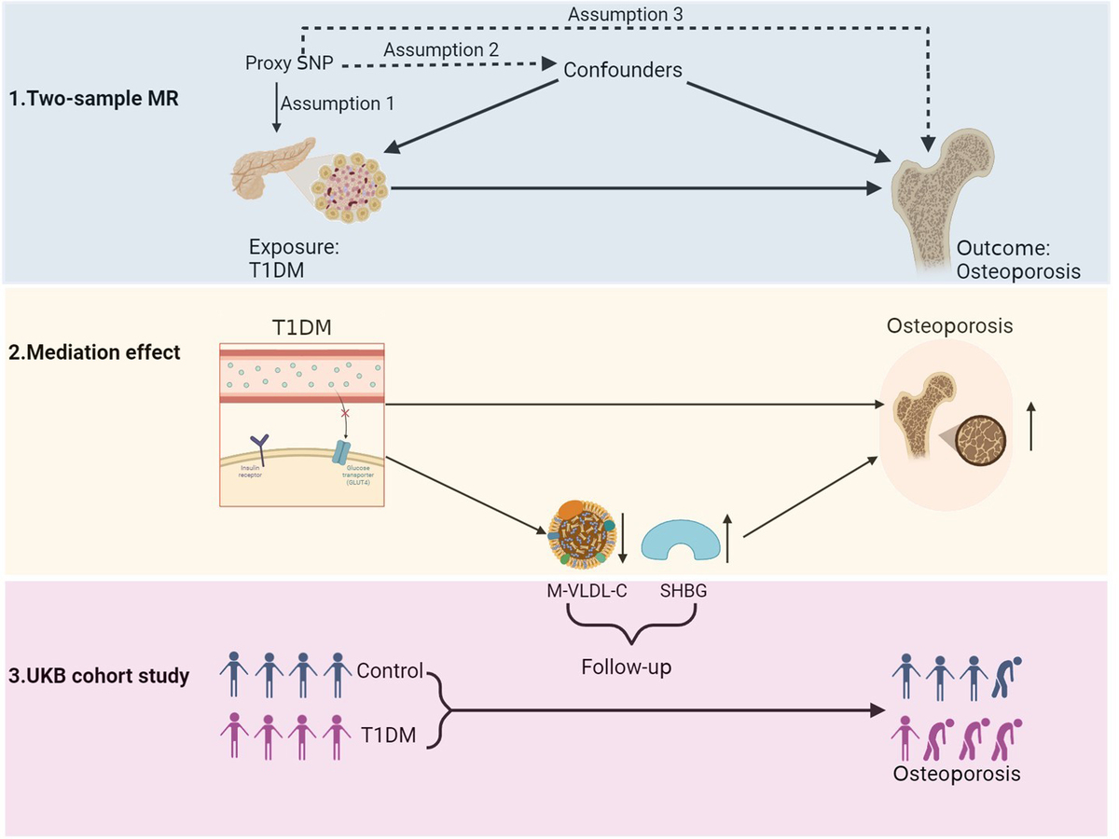

Metabolic mediators linking type 1 diabetes mellitus to osteoporosis
DOI: 10.5114/aoms/202218
Arch Med Sci 2026;22(1):316-324
Notes:
Introduction
The causal relationship between type 1 diabetes mellitus (T1DM) and osteoporosis has not been clarified in large prospective cohort studies. This study aimed to assess the causal association between T1DM and osteoporosis, and further identify eligible mediators.
Material and methods
We explored the causal relationship between T1DM and osteoporosis by two-sample Mendelian randomization (MR), a method that uses genetic variants as instrumental variables for causal inference. We selected five candidate mediators based on their relevance to metabolic processes in T1DM and bone health, including body mass index (BMI), glycated hemoglobin (HbA1c), cholesterol in medium very low-density lipoprotein particles (M-VLDL-C), saturated fatty acids (SFA), and sex hormone-binding globulin (SHBG), and identified eligible mediators by two-step MR. We validated the correlation of T1DM and mediators with osteoporosis in a UK Biobank (UKB) prospective cohort study.
Results
In MR analysis, T1DM was related to a significantly increased risk of osteoporosis (OR = 1.046, 95% CI: 1.015 to 1.079, p = 0.004). In two-step MR, T1DM was significantly associated with decreased levels of M-VLDL-C and SFA and increased levels of SHBG, but showed no significant effect on BMI or HbA1c. Furthermore, lower levels of M-VLDL-C and higher levels of SHBG, but not SFA, were significantly associated with an elevated risk of osteoporosis. Hence M-VLDL-C and SHBG were identified as eligible mediators. In the UKB cohort study, consistent results were found.
Conclusions
T1DM may cause osteoporosis by reducing M-VLDL-C and increasing SHBG levels in plasma. The identified mediators may serve as important biomarkers for early detection and treatment of osteoporosis in T1DM patients.

