Slide 1
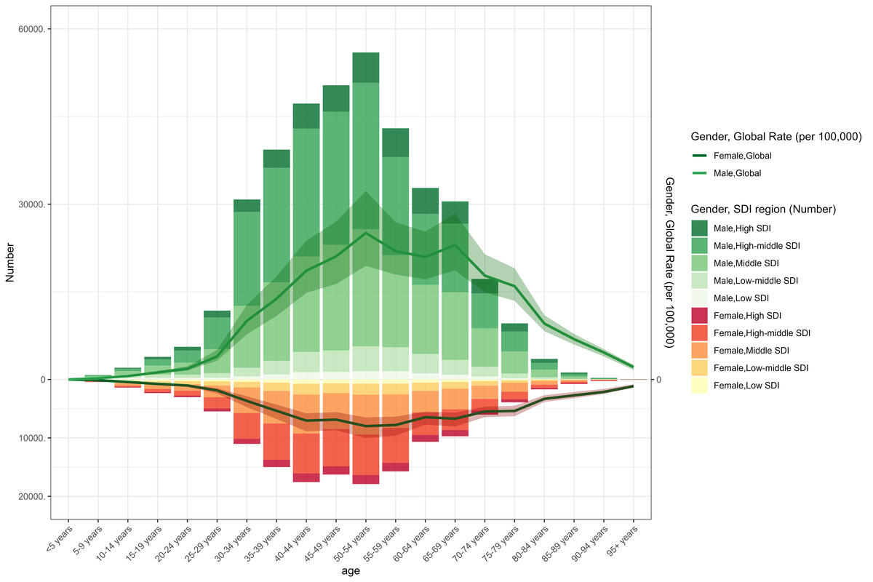

Global health implications of urticaria burden (1990–2021): a comprehensive analysis of trends across nations and regions
DOI: 10.5114/aoms/202415
Notes:
Introduction
Urticaria is a widespread dermatological disorder that substantially affects patients’ quality of life. Current data on its worldwide impact are crucial for healthcare planning and resource distribution. By analyzing the Global Burden of Disease (GBD) Study 2021, we evaluated the burden of urticaria across global, regional, and national levels.
Material and methods
A comprehensive analysis was performed using data from the GBD 2021 study. Key metrics included prevalence, incidence, and age-standardized rates, all calculated per 100,000 people. The results were analyzed across demographic factors including age groups, gender, and geographical locations.
Results
From 1990 to 2021, global urticaria metrics demonstrated relative stability, with female patients consistently reporting higher rates. During this period, the number of prevalent cases increased from approximately 48 million to 66.5 million, with the age-standardized prevalence rate (ASPR) showing a slight rise from 866 to 868 per 100,000 population. The number of incident cases increased from about 85 million to 117 million, while the age-standardized incidence rate (ASIR) showed a marginal increase from 1,529 to 1,534 per 100,000. The global age-standardized DALY rate reached 52.1 per 100,000 in 2021, ranging from 27.7 in Portugal to 88.4 in Nepal. The disease burden was most pronounced in low-middle SDI regions and lowest in high SDI areas. At the country level, Nepal recorded the highest burden across all metrics, while Portugal showed the lowest.
Conclusions
Our analysis spanning three decades revealed that while the overall global burden of urticaria has remained relatively stable, there has been a modest upward trend in both prevalence and incidence. Notable disparities have emerged, with disproportionate impacts observed across different populations: females experience higher rates of the condition, and low-middle SDI regions shoulder a greater disease burden. These patterns highlight the importance of developing focused healthcare strategies and optimizing resource distribution, particularly in heavily affected regions. Given the inherent limitations of GBD data, these findings should be interpreted with appropriate caution.

