Slide 1
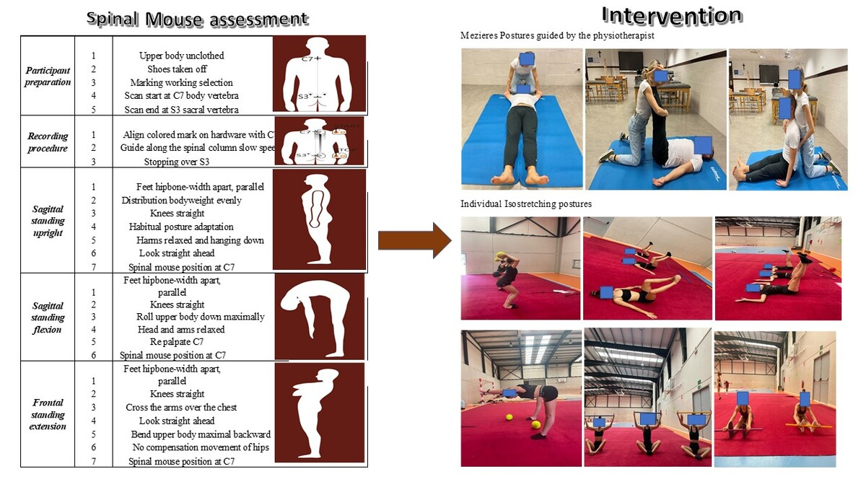

A double-blind randomized controlled trial comparing the effects of the Mézières method and Isostretching postures in sagittal stand position evaluated through the Spinal Mouse<sup>®</sup> in elite rhythmic gymnasts with low back pain
DOI: 10.5114/aoms/202432
Arch Med Sci 2025;21(1):327-338
Notes:
Introduction
Material and methods
Results
Conclusions

