Slide 1
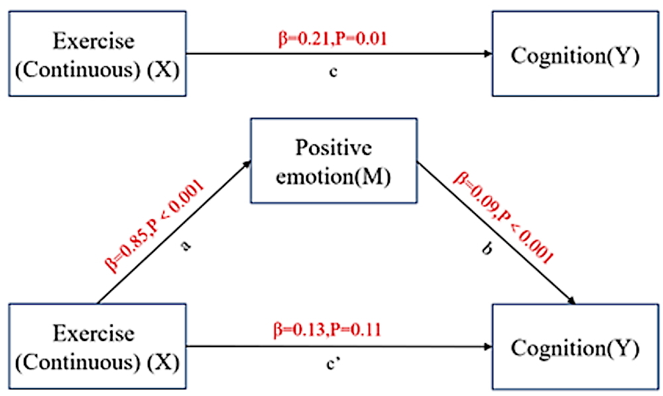

Association between continuous exercise and cognitive function in Chinese elderly with chronic diseases: the mediating role of positive emotions
DOI: 10.5114/aoms/202503
Notes:
Introduction
Exercise has been proven to have a positive effect on improving cognitive function. However, the specific mechanisms by which exercise affects cognitive function states remain unclear. We aimed to explore the association between continuous exercise and cognitive function in Chinese elderly（age≥65）with chronic diseases and the mediating role of positive emotions.
Material and methods
Data were obtained from 2018 waves of the Chinese Longitudinal Healthy Longevity Survey. We relied on the database entries for the types of chronic diseases to assess whether the samples had chronic diseases. We used logistic regression to verify correlations between exercise and cognition, and the Karlson-Holm-Breen Method (KHB) to verify the mediating role of positive emotions.
Results
3959 samples were included in this study, of which 36.37% were <75 years old, 35.87% were 75-84 years old, and 27.76% were ≥85 years old; 46.70% were females and 53.30% were males. Logistic regression results showed that continuous exercise was significantly associated with an increase in cognition (β=0.21,P=0.01). About different domains of cognition, logistic regression results indicated that continuous exercise and non-continuous exercise are significantly associated with the growth of positive emotion (β=0.57,P＜0.001; β=0.85,P＜0.001). The results of regression and KHB methods indicated that positive emotions fully mediated the effects of continuous exercise on cognition, and partially mediated the effects of exercise on orientation.
Conclusions
Exercise could improve levels of orientation of cognition of Chinese elderly with chronic diseases, and positive emotions mediated this effect. Only continuous exercise that produced positive emotions could have an impact on cognition ability.

