Slide 1
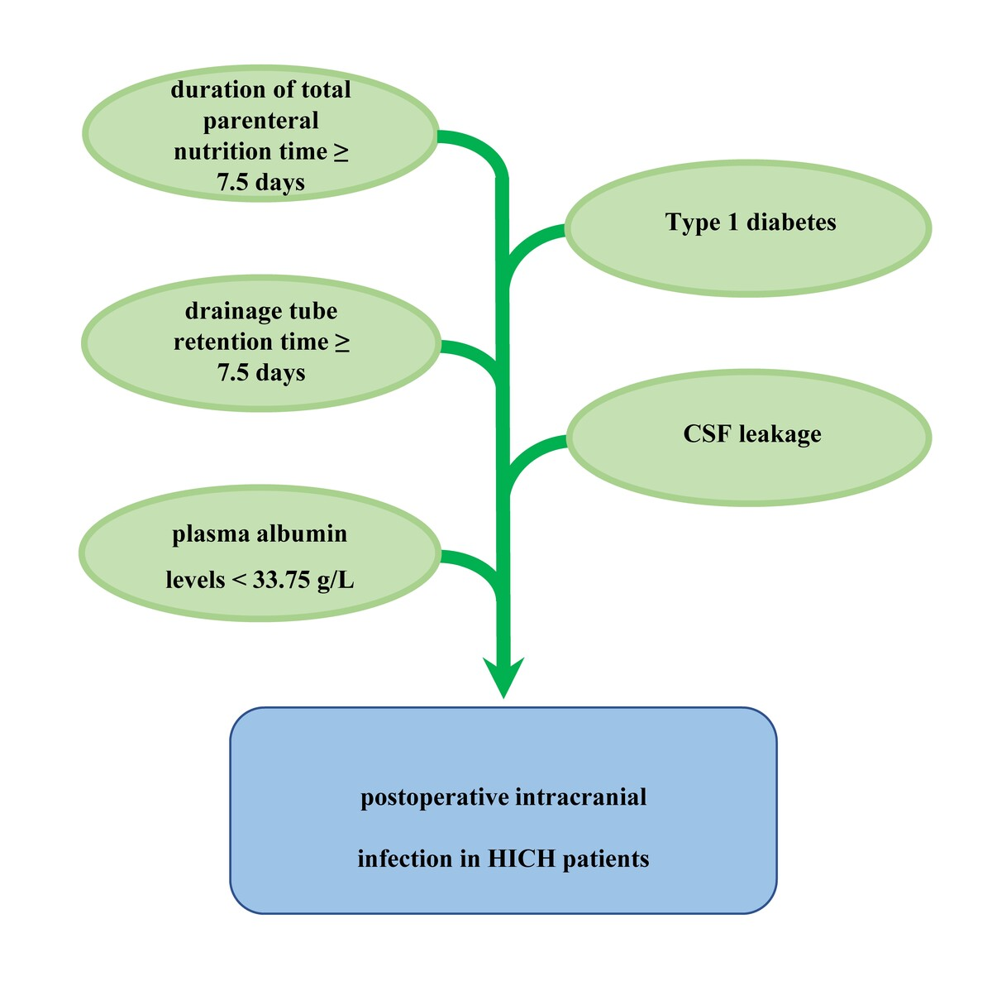

Risk factors of postoperative intracranial infection in individuals suffering from hypertensive intracerebral hemorrhage
DOI: 10.5114/aoms/202504
Notes:
Introduction
It can be fatal for individuals with hypertensive intracerebral hemorrhage (HICH) to have a postoperative intracranial infection. It's yet unknown what risk factors led to this emergence. Therefore, the clinical variables for intracranial infection following HICH surgery were investigated.
Material and methods
3253 HICH patients who underwent hematoma removal surgery were enrolled. For every patient, clinical traits were obtained. To determine the variables that were independently linked to intracranial infection following HICH surgery, univariate/multivariate logistic regression analyses were used. The analysis of the receiver operating characteristic (ROC) curve was carried out to ascertain the threshold values for continuous parameters that predict postoperative intracranial infection in HICH patients.
Results
300 patients suffered from intracranial infection. Multivariate logistic regression indicated that, following HICH surgery, drainage tube retention time, duration of total parenteral nutrition (TPN) time, cerebrospinal fluid (CSF) leakage, type 1 diabetes, and plasma albumin levels were the separate susceptibility variables for cerebral infection. The ROC curve displayed that the area under the curve for drainage tube retention time (cutoff value, 7.5 days), plasma albumin levels (cutoff value, 33.75 g/L), and duration of TPN time (cutoff value, 7.5 days) were 0.756, 0.977, and 0.895, respectively.
Conclusions
Duration of TPN time ≥ 7.5 days, type 1 diabetes, CSF leakage, drainage tube retention time ≥ 7.5 days, and plasma albumin levels < 33.75 g/L were independent risk factors for postoperative intracranial infection in HICH patients. More attention should be provided to the contributors to minimize the frequency of this complication.

