Slide 1
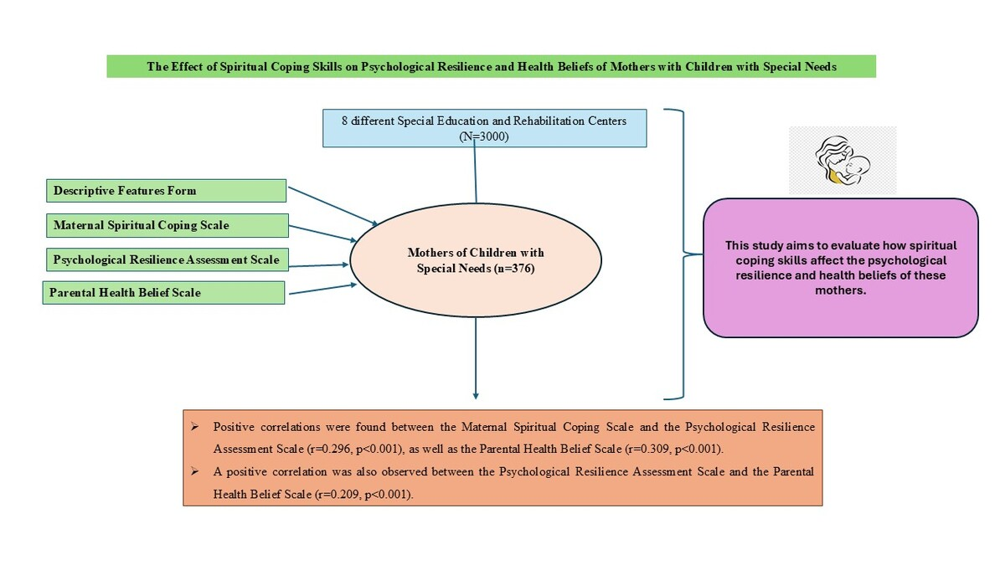

Association of spiritual coping skills with psychological resilience and health beliefs of mothers of children with special needs
DOI: 10.5114/aoms/202613
Notes:
Introduction
Mothers of children with special needs face various responsibilities and challenges in daily life. They not only manage their children’s care and needs but also strive to maintain their own psychological resilience. This study aimed to explore the mediating role of spiritual coping skills in the psychological resilience and health beliefs of these mothers.
Material and methods
A cross-sectional descriptive design was used, following STROBE reporting guidelines. The study involved 3000 mothers from eight special education and rehabilitation centers, with 376 mothers selected through proportional stratified random sampling. Data were collected using the ‘Descriptive Characteristics Form,’ ‘Maternal Spiritual Coping Scale,’ ‘Psychological Resilience Assessment Scale,’ and ‘Parental Health Belief Scale.’ Descriptive analyses were conducted for demographic data and parameter results, while regression analysis was used to assess relationships between variables, and correlation coefficients were calculated. Data were analyzed using a specialized statistical program.
Results
Positive correlations were found between the Maternal Spiritual Coping Scale and the Psychological Resilience Assessment Scale (r = 0.296, p < 0.001), as well as the Parental Health Belief Scale (r = 0.309, p < 0.001). A positive correlation was also observed between the Psychological Resilience Assessment Scale and the Parental Health Belief Scale (r = 0.209, p < 0.001).
Conclusions
The study found that mothers’ spiritual coping strategies were associated with their psychological health and their attitudes towards their children’s health problems.

