Slide 1
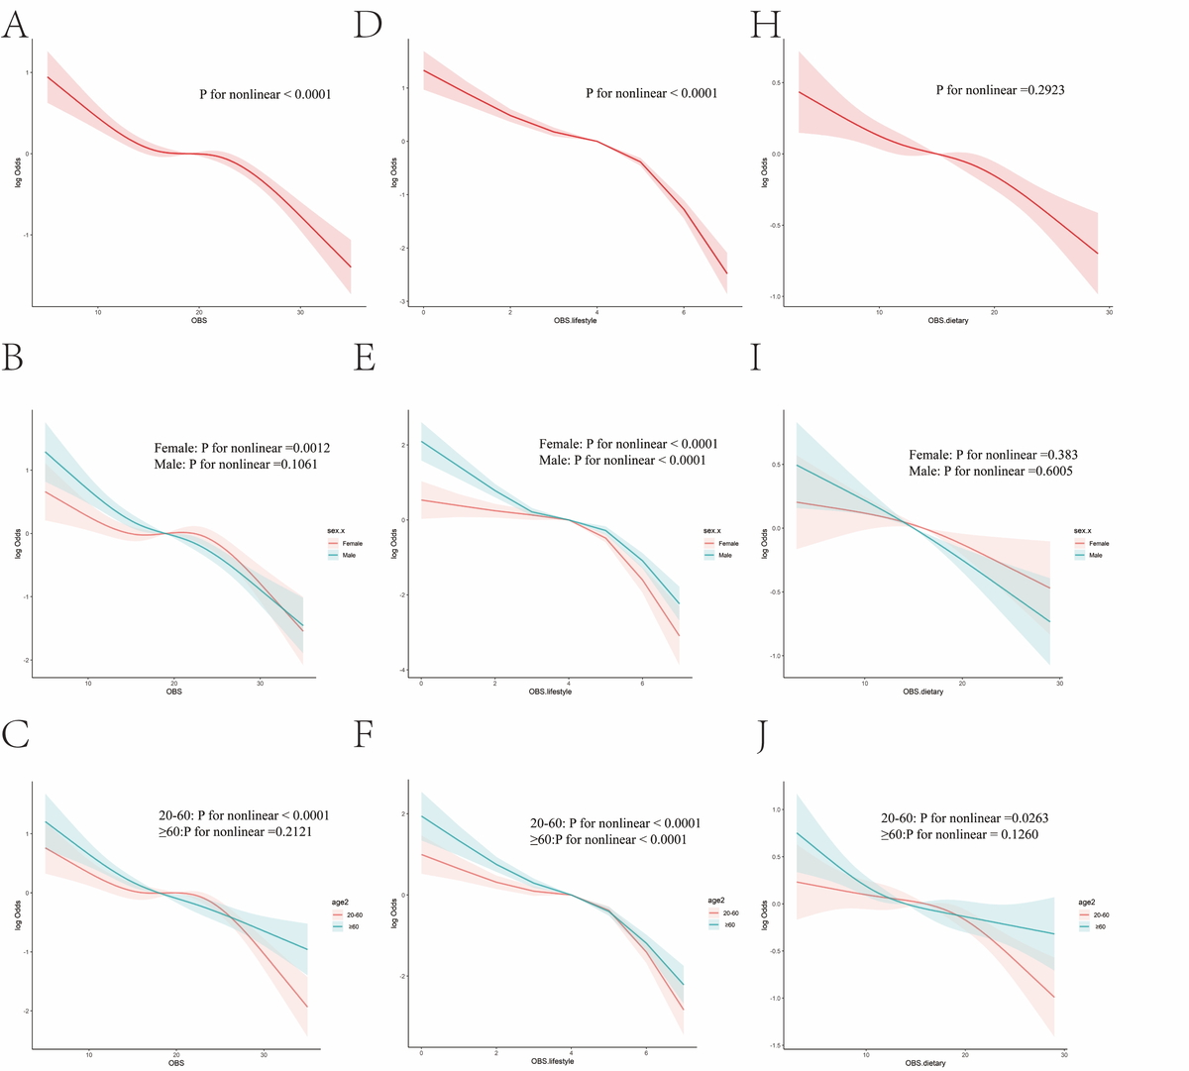

Higher lifestyle oxidative balance scores are associated with lower metabolic dysfunction-associated fatty liver disease and fibrosis risk in US adults, while dietary scores have no impact on fibrosis
DOI: 10.5114/aoms/202700
Arch Med Sci 2025;21(4):1241-1251
Notes:
Introduction
Metabolic dysfunction related steatotic liver disease (MASLD) is a long-term liver disease. Oxidative stress plays a key role in MASLD. The oxidative balance score (OBS) measures oxidative and reactive stress, but its relationship with MASLD and fibrosis remains unclear.
Material and methods
The National Health and Nutrition Examination Survey records from 1999 to 2018 were used in this study. We used weighted multivariate logistic regression, subgroup studies, and restricted cubic spline regression to examine the associations between OBS and MASLD and fibrosis. Sensitivity studies were conducted to evaluate the robustness of the results.
Results
A total of 12,272 people enrolled in the study. There was a strong negative relationship between OBS and MASLD, and all <i>p</i>-values for interactions were less than 0.05. After adjusting for potential confounders, people with higher OBS had a lower risk of MASLD (OR = 0.37, 95% CI (0.27–0.51), <i>p</i> for trend < 0.001). Then, the stratified studies showed that lifestyle OBS was significantly associated with MASLD in both men and women, but dietary OBS was only significantly associated with MASLD in men (OR = 0.95, 95% CI (0.93, 0.98), <i>p</i> < 0.001). Finally, lifestyle OBS showed a strong association with MASLD-related fibrosis (OR = 0.37, 95% CI (0.24, 0.56), <i>p</i> for trend < 0.0001). In the subgroup studies, the findings remained consistent.
Conclusions
OBS was associated with a lower risk of MASLD, and lifestyle OBS showed strong protective effects against MASLD and fibrosis. Because of this, people who have MASLD and fibrosis should focus on researching and looking into antioxidant treatment that is based on dietary and lifestyle, with particular emphasis on lifestyle factors.

