Slide 1
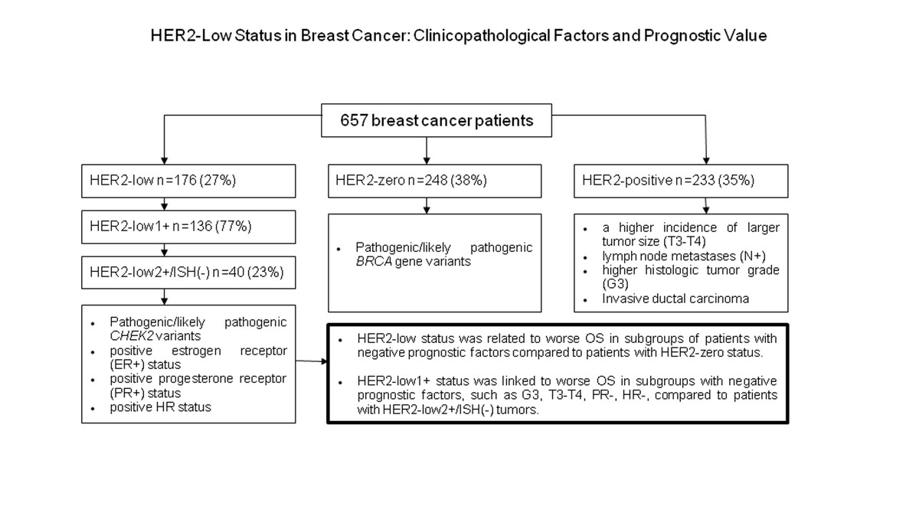

HER2-low status in breast cancer: clinicopathological factors and prognostic value
DOI: 10.5114/aoms/202777
Arch Med Sci 2026;22(2):804-814
Notes:
Introduction
This study aimed to assess the prognostic importance of HER2-low status in breast cancer (BC). Additionally, we compared the HER2-low subgroup (defined as HER2-low1+; HER2-low2+/ISH(-)) with HER2-zero and HER2-positive subgroups according to clinical, histopathological, and molecular characteristics.
Material and methods
The study analyzed the medical records of BC patients treated at the National Institute of Oncology in Gliwice, Poland, between 2002 and 2018. HER2 overexpression was assessed in postoperative specimens or samples obtained via core needle biopsy.
Results
Of the 657 tumors, 176 (27%) tumors were classified as HER2-low BC, 248 (38%) as HER2-zero and 233 (35%) as HER2-positive tumors. BC patients with HER2-low tumors were more likely to have hormone receptor-positive (HR+) status compared to those with HER2-zero tumors (82.4% vs. 62.1%, p < 0.001). Specifically, patients with HER2-low1+ tumors had a higher frequency of HR+ status versus both HER2-zero and HER2-positive tumors. Similarly, patients with HER2-low2+/ISH(-) tumors were more frequently characterized as HR+ compared to HER2-zero and HER2-positive patients. In the subgroup of patients with estrogen receptor negative tumors, overall survival (OS) was slightly worse than for those with HER2-low status compared to HER2-zero patients (5-year OS 72.6% vs. 86.7%, p = 0.074). Non-significantly poorer OS was noted in HER2-low1+ patients with negative prognostic factors, including HR-, progesterone receptor-negative, grade 3, and larger tumors.
Conclusions
HER2-low status was associated with worse OS in breast cancer patients with certain negative prognostic factors compared with HER2-zero status. Additionally, HER2-low1+ and HER2-low2+/ISH(-) subgroups predominantly exhibited HR+ status.

