Slide 1
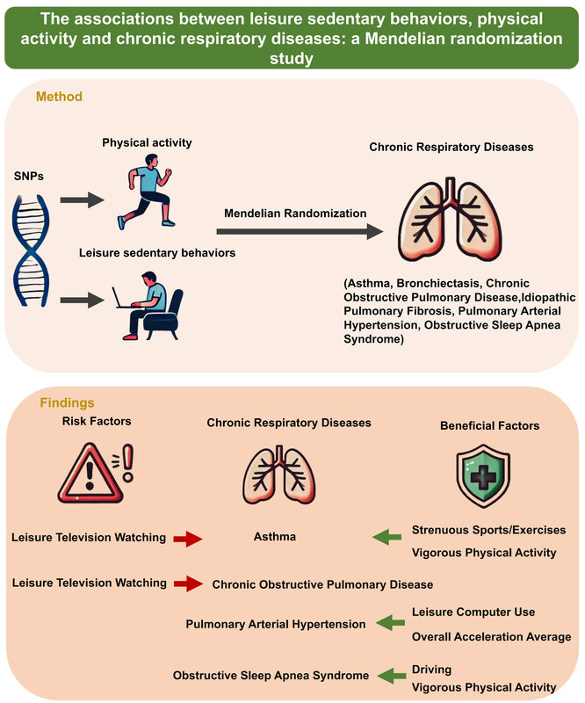

Associations between leisure sedentary behaviors, physical activity, and chronic respiratory diseases: a Mendelian randomization study
DOI: 10.5114/aoms/202834
Arch Med Sci 2025;21(6):2710-2719
Notes:
Introduction
Chronic respiratory diseases represent a significant global health burden, characterized by high incidence and mortality rates. However, the potential associations between physical activity, leisure sedentary behavior, and susceptibility to chronic respiratory diseases remain uncertain.
Material and methods
A two-sample Mendelian randomization approach was used in this investigation, using physical activity and leisure sedentary behavior as exposures, and common chronic respiratory diseases such as asthma, bronchiectasis, chronic obstructive pulmonary disease, idiopathic pulmonary fibrosis, pulmonary arterial hypertension, and obstructive sleep apnea syndrome as outcomes, to explore the genetic causal relationships. We utilized genome-wide association studies to select genetic instrumental variables related to these exposures. These variables were then used to assess the impact of physical activity and leisure sedentary behavior on the susceptibility to chronic respiratory diseases.
Results
Our findings indicate that strenuous sports or other exercises and vigorous physical activity are protective factors against asthma, whereas leisure-time television watching is a risk factor. Frequent leisure-time television watching is closely associated with an increased susceptibility to chronic obstructive pulmonary disease. Leisure-time computer use and overall average acceleration in physical activity are inversely related to the risk of developing pulmonary arterial hypertension. Higher engagement in driving and vigorous physical activity are causally associated with a reduced risk of obstructive sleep apnea syndrome.
Conclusions
Our analysis supports the causal relationships between physical activity, sedentary behavior, and chronic respiratory diseases, providing genetic evidence that supports lifestyle modifications to reduce susceptibility to these conditions.

