Slide 1
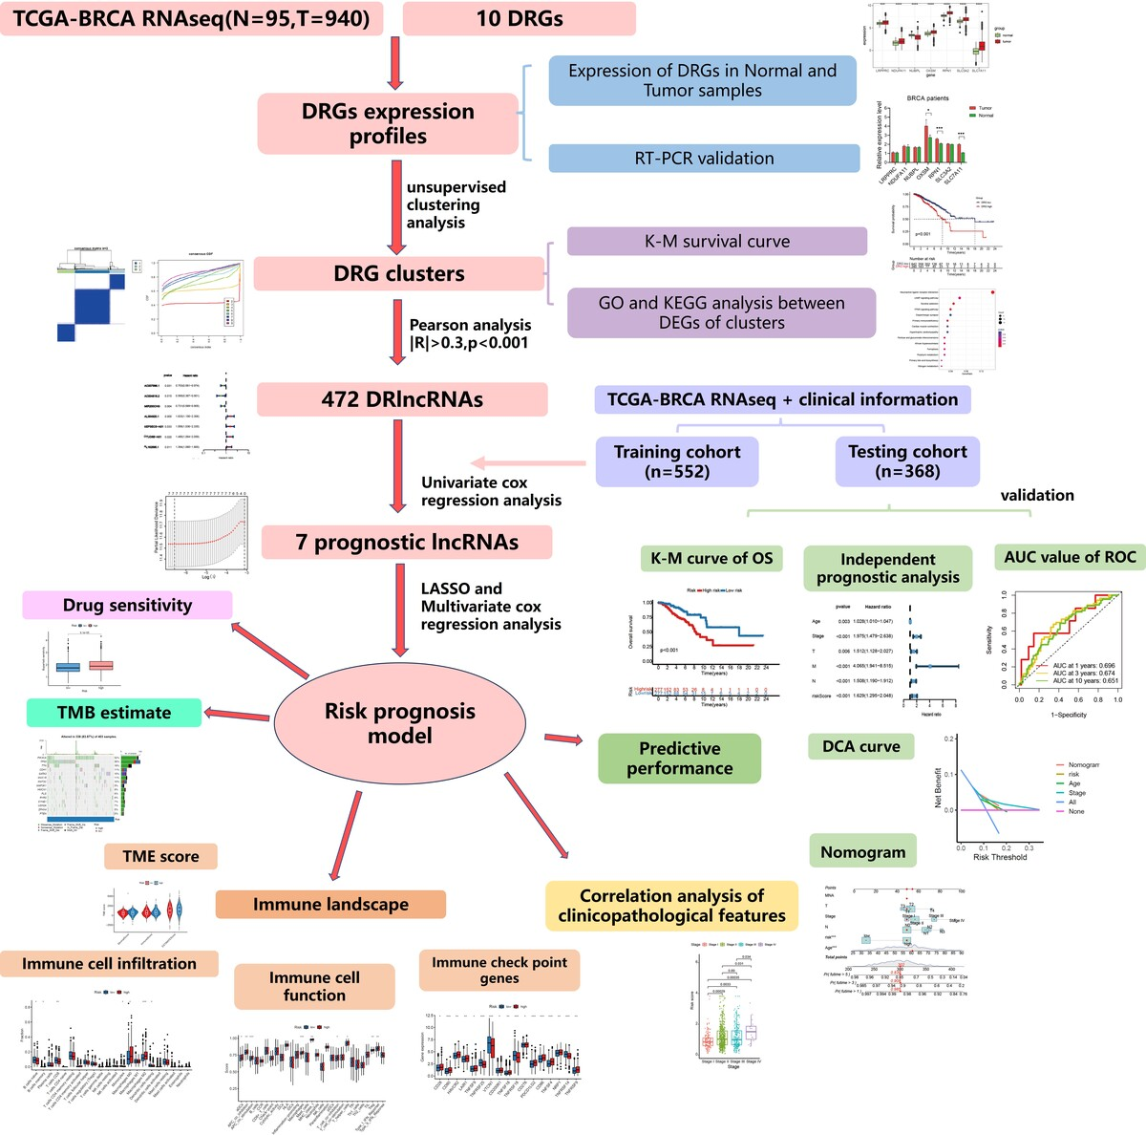

Development and verification of a novel disulfidptosis-related lncRNA prognostic model for predicting the immune environment and treatment of breast cancer
DOI: 10.5114/aoms/203010
Notes:
Introduction
Breast cancer is the leading cause of cancer-related death in women. Disulfidptosis is a recently identified type of cell death that may offer new opportunities for cancer treatment. However, it is uncertain whether disulfidptosis-related lncRNAs (DRlncRNAs) are associated with BRCA.
Material and methods
We first evaluated the expression of disulfidptosis-related genes (DRGs) by RT-PCR. We then identified DRlncRNAs using Pearson’s correlation, followed by univariate regression to select prognosis-related genes. LASSO regression and multivariate Cox regression were used to construct a prognostic model, and ROC curves were used to evaluate the model’s predictive performance. We compared infiltration of various immune cells and expression of immune checkpoint genes between risk groups. Maftools was employed to analyze the tumor mutation burden (TMB) of patients. Finally, the pRRophetic package was used to analyze the sensitivity of patients to anticancer drugs.
Results
We found that OXSM, RPN1, SLC3A2, and SLC7A11 showed increased expression levels in tumor tissues compared to normal tissues. We then constructed and validated a prognostic model (AC007996.1, AC004816.2, MIR200CHG, AL354920.1). Patients in the high-risk group had significantly reduced percentages of naive B cells and CD8+ T cells, and higher expression levels of immune checkpoint-related genes compared to patients in the low-risk group, suggesting immune escape ability of the high-risk group. Patients in the high-risk group had a higher TMB. Finally, patients in the high-risk group had higher IC50 values for many targeted agents, suggesting poor drug sensitivity.
Conclusions
We identified DRG expression in breast cancer, and constructed a prognostic model predicting the prognosis, the immune microenvironment, TMB, and drug sensitivity.

