Slide 1
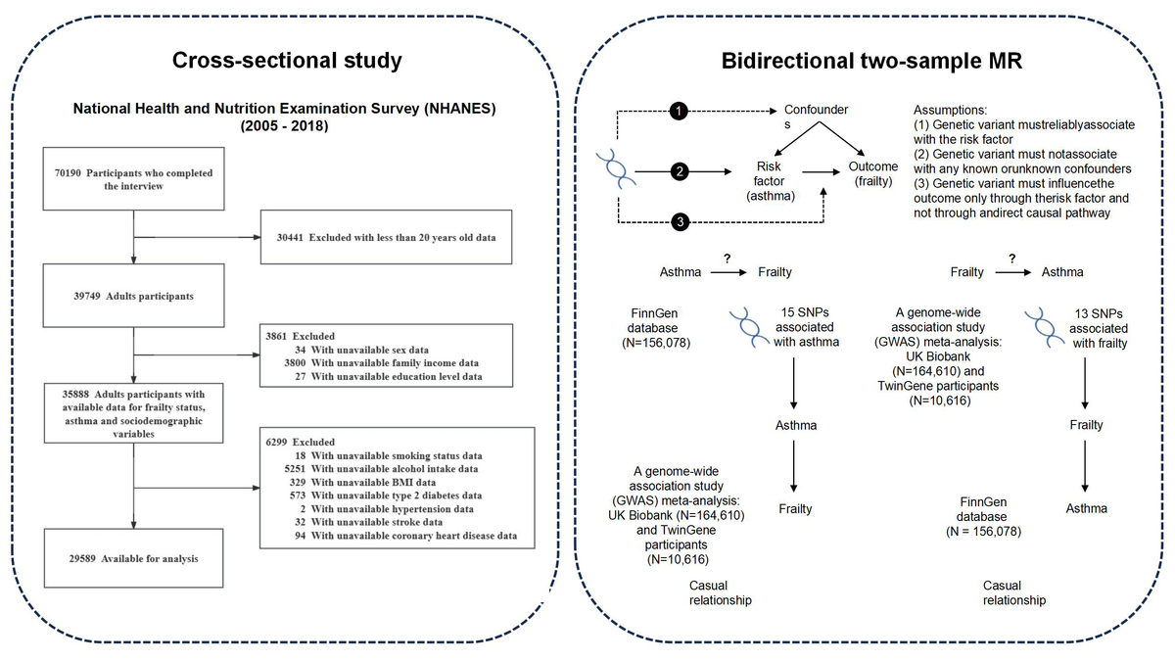

Exploring the association between asthma and frailty: a cross-sectional and a bidirectional Mendelian randomization study
DOI: 10.5114/aoms/203471
Arch Med Sci 2026;22(2):871-883
Notes:
Introduction
Observational studies suggest a potential association between asthma and frailty, but the causal relationship remains unclear. This study aimed to explore this association and determine its causal nature, with implications for targeted interventions that could improve patient management and quality of life.
Material and methods
This study analyzed cross-sectional data from the National Health and Nutrition Examination Survey and included 29,589 participants. Multivariate logistic regression was used to assess the association between asthma and frailty, with propensity score matching for reliability. Bidirectional Mendelian randomization (MR) was used, with genetic variants associated with asthma and frailty obtained from the FinnGen database and a large GWAS meta-analysis. Causal effects were estimated using inverse variance weighting, with sensitivity analyses for robustness.
Results
Cross-sectional analysis found a significant association between asthma and frailty (OR = 2.16; 95% CI: 2.01–2.31; p < 0.001). After adjusting for confounders using multiple methods, this association remained significant, with ORs ranging from 1.60 to 2.04, all p < 0.001. MR analysis revealed a bidirectional causal relationship: Genetically predicted asthma was significantly associated with an increased risk of frailty, with an OR of 1.091 (95% CI: 1.061–1.123). In the reverse direction analysis, genetic liability to frailty was also significantly associated with an increased risk of asthma, with an OR of 2.264 (95% CI: 1.503–3.409).
Conclusions
This study suggests a bidirectional causal association between asthma and frailty. Routine screening for frailty in asthma patients is recommended, and further research is needed to explore the underlying mechanisms.

