Slide 1
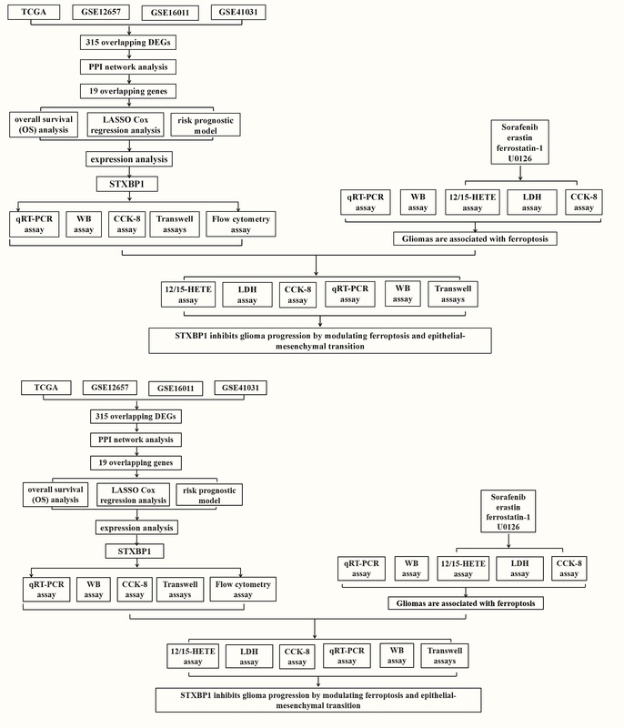

<i>STXBP1</i> inhibits glioma progression by modulating ferroptosis and epithelial-mesenchymal transition
DOI: 10.5114/aoms/203472
Arch Med Sci 2026;22(2):1097-1118
Notes:
Introduction
This study investigated the role of STXBP1 in glioma, particularly its involvement in regulating ferroptosis and epithelial-mesenchymal transition (EMT), and examined its impact on glioma cell behavior.
Material and methods
Differential gene expression analysis was performed on a glioma dataset, and protein-protein interaction (PPI) network analysis identified genes with significant prognostic value. Least absolute shrinkage and selection operator (LASSO) Cox regression analysis further narrowed the scope. Key genes were obtained through nomogram analysis, and expression verification was performed. In in vitro cell experiments, knockdown of STXBP1 was performed in glioma cell lines. The effects on cell proliferation, migration, invasion, cell cycle distribution, apoptosis, and markers of ferroptosis and EMT were assessed.
Results
After bioinformatics analysis, STXBP1 was identified as a hub gene, and in vitro cell experiments were performed. STXBP1 knockdown in glioma cells increased proliferation, migration, and invasion, altered cell cycle distribution (reducing S phase and increasing G1 phase), and decreased apoptosis. Ferroptosis markers showed elevated GPX4 expression and reduced 12-HETE and 15-HETE levels. Ferroptosis inducers (sorafenib, erastin) heightened LDH release and reduced viability, while inhibitors (ferrostatin-1, U0126) had opposing effects. STXBP1 knockdown also reduced lipid peroxidation and mitigated the cytotoxic effects of sorafenib, indicating a role in ferroptosis regulation. Additionally, STXBP1 knockdown impacted EMT markers, decreasing N-cadherin and vimentin and increasing E-cadherin.
Conclusions
STXBP1 functions as a tumor suppressor in glioma, regulating ferroptosis and EMT. It shows potential as a therapeutic target in glioma management.

