Slide 1
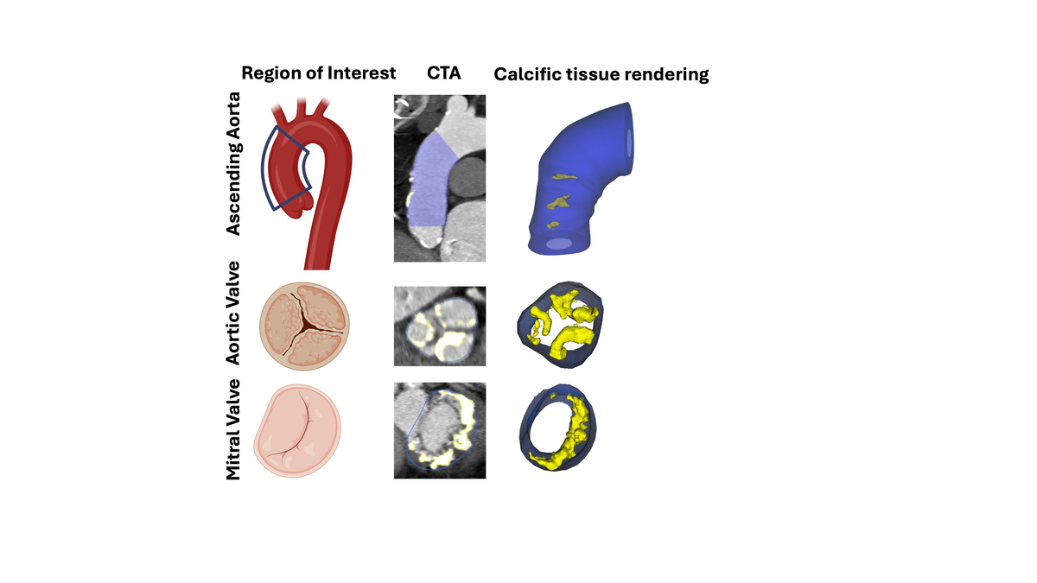

Interplay between parathyroid hormone concentration and valvular and aortic calcifications
DOI: 10.5114/aoms/203473
Arch Med Sci 2026;22(2):735-742
Notes:
Introduction
Recently, a relationship between hyperparathyroidism and cardiovascular disorders has been highlighted. The current study aimed to identify a potential relationship between parathyroid hormone (PTH) and valvular calcification performance. A secondary aim was to evaluate the potential association between PTH concentration and post-procedural outcomes after transcatheter aortic valve implantation (TAVI).
Material and methods
Patients with severe symptomatic aortic stenosis were evaluated for study eligibility. Demographics, clinical data, and blood samples were collected. Pre-procedurally, echocardiography and computed tomography (CT) were performed. Quantitative evaluation of calcific tissue was conducted over the three regions of interest – ascending aorta, aortic and mitral valves – using semiautomated software.
Results
The final study group comprised 89 patients (50 females, median (Q1-3) age of 77 (72–82) years. Increased PTH concentration was associated with a higher peak aortic gradient (p = 0.024), but not with mean aortic gradient or mitral annular calcification occurrence. CT analysis revealed an association between increased PTH and mean calcific tissue attenuation in the mitral (p = 0.004) and aortic valves (p < 0.001) and ascending aorta (p < 0.001) but no relationship with calcium volume in the regions of interest. Increased PTH did not differ between patients with and without paravalvular leak or new pacemaker implantation.
Conclusions
Increased PTH concentration is associated with calcific tissue attenuation but not calcium volume, suggesting that PTH may influence the degree of calcium accumulation in degenerated regions. PTH could potentially serve as a biomarker of calcific loading in valvular heart disease. However, PTH concentration does not appear to be associated with the rate of complications following TAVI.

