Slide 1
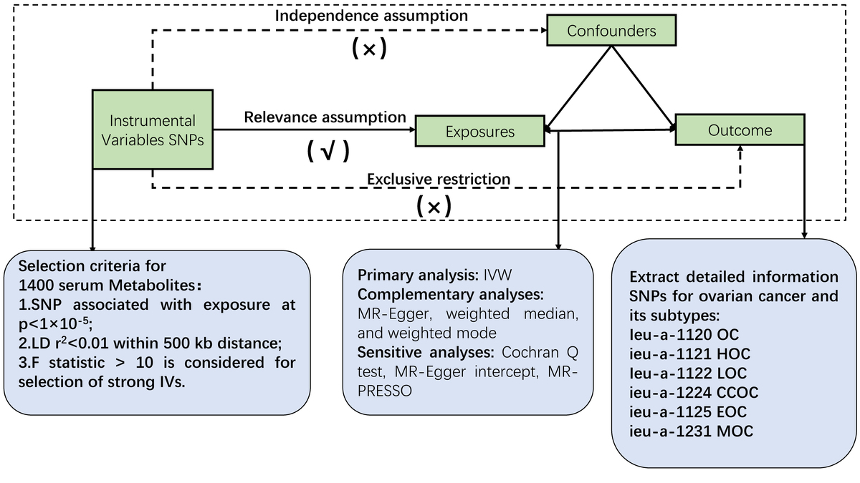

Mendelian randomization analysis of 1,400 genetically predicted blood metabolites and ovarian cancer risk
DOI: 10.5114/aoms/203475
Arch Med Sci 2026;22(2):1011-1021
Notes:
Introduction
Ovarian cancer is a malignant tumor and a major threat to women’s health. Its development is influenced by diverse factors, among which metabolic dysregulation is increasingly recognized. However, evidence for a causal relationship between metabolic changes and ovarian cancer remains limited. This study aimed to identify potential biomarkers for early screening and a targeted therapeutic strategy.
Material and methods
A genome-wide association study (GWAS) and a two-sample Mendelian randomization (MR) analysis were applied. Causality was primarily assessed using the random inverse variance weighted (IVW) method. Cross-validation was conducted with MR-Egger, weighted median, and weighted mode approaches. The MR-Egger intercept and Cochran’s Q test were adopted to assess heterogeneity and pleiotropy. Pathway enrichment analysis was performed using MetaboAnalyst 6.0. Our research identified key metabolites as potential biomarkers for early screening and personalized therapy in ovarian cancer. By using MR, we established causal associations between ovarian cancer subtypes and plasma metabolites, offering valuable insights for clinical applications.
Results
After false discovery rate (FDR) correction, one metabolite, 5-acetylamino-6-amino-3-methyluracil (AAMU), was found to be significantly associated with ovarian cancer risk. Also, significant metabolites were enriched in caffeine metabolism (p < 0.05) as the most significant metabolic pathway in ovarian cancer.
Conclusions
We integrated genomic and metabolomic analyses to reveal causal associations of metabolites with ovarian cancer and its subtypes. Certain metabolites were identified as prospective biomarkers for ovarian cancer.

