Slide 1
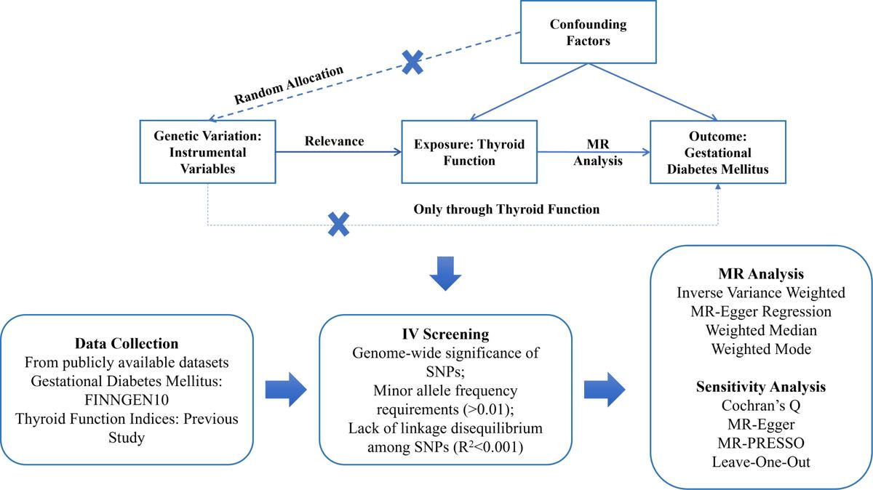

Unraveling the underlying causality: a two-sample Mendelian randomization analysis of the association between thyroid function and gestational diabetes mellitus
DOI: 10.5114/aoms/203511
Arch Med Sci 2026;22(3):1549-1556
Notes:
Introduction
Previous studies on the relationship between thyroid function disturbance and the development of gestational diabetes mellitus (GDM) have reported inconsistent results. We aimed to investigate the relationship between thyroid function disturbance and GDM using Mendelian randomization (MR) analysis.
Material and methods
This MR study used summary data from genome-wide association studies (GWAS) of thyroid function disturbance (18,297 individuals) and GDM (41,647 participants). The inverse variance weighted (IVW) method was primarily employed for analysis, complemented by the weighted median, weighted mode, and MR-Egger regression. Sensitivity analyses included MR-Egger, MR-PRESSO, Cochran’s Q, and leave-one-out approaches to assess the robustness of the findings.
Results
The genetically determined thyroid function disturbance did not exhibit a statistically significant causal effect on GDM (FT4: OR = 0.99, 95% CI: 0.88–1.11, p = 0.84; TT3: OR = 1.10, 95% CI: 0.98–1.24, p = 0.12; FT3: OR = 1.16, 95% CI: 0.96–1.40, p = 0.13; TSH: OR = 1.01, 95% CI: 0.94–1.08, p = 0.83; FT3/FT4: OR = 1.05, 95% CI: 0.58–1.91, p = 0.87). The sensitivity analysis revealed no significant horizontal pleiotropy and identified outliers that, once excluded, did not alter the negative findings, confirming the robustness of the outcomes.
Conclusions
Our study found no significant causal effect of thyroid function disturbance on the risk of GDM based on the MR analysis, highlighting the need for further research to explore alternative mechanisms or potential subgroups where thyroid function may play a role in GDM development.

