Slide 1
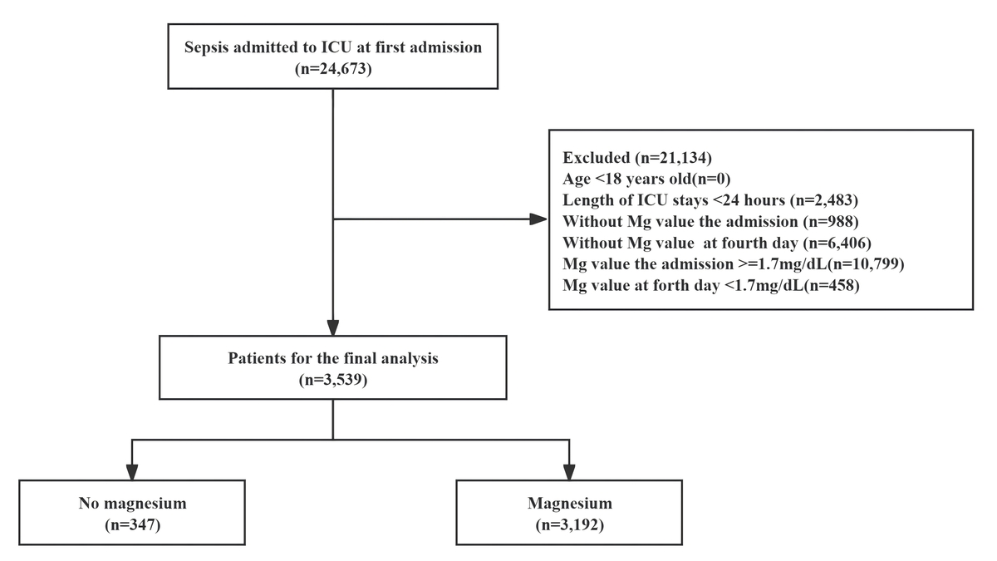

The impact of magnesium sulfate administration on
the prognosis of septic patients with hypomagnesemia:
a retrospective propensity score-matched cohort study
based on MIMIC-IV
DOI: 10.5114/aoms/203512
Notes:
Introduction
This study aimed to provide a basis for optimizing clinical treatment by retrospectively analyzing the clinical characteristics of hypomagnesemia in sepsis patients and the impact of magnesium sulfate administration on their prognosis.
Material and methods
Based on inclusion and exclusion criteria, we included adult individuals diagnosed with sepsis and concurrent hypomagnesemia. Exposure was defined as administration of magnesium sulfate on the first day of ICU admission. The primary outcome assessed was the 28-day mortality rate. Secondary outcomes encompassed mortality rates at 90 and 365 days, the duration of mechanical ventilation, requirement for continuous renal replacement therapy (CRRT), hospital stay duration, intensive care unit (ICU) stay duration, hospital mortality, and ICU mortality. A multivariable Cox regression analysis was conducted to evaluate the relationship between sepsis with hypomagnesemia and 28-day mortality. Propensity score matching (PSM) was performed at a 1 : 1 ratio. Multivariable analysis was used to adjust for confounding factors.
Results
In the PSM analysis, the 28-day mortality rate appeared reduced in the magnesium sulfate treatment group relative to the untreated group (10.15% [33/3192] vs. 16.31% [53/347]). Magnesium sulfate use correlated with a decreased 28-day mortality rate (hazard ratio [HR] = 0.61; 95% CI: 0.39–0.94; p = 0.026). Magnesium sulfate administration also reduced the 90-day mortality rate (p = 0.039). Statistical analysis revealed no significant differences between magnesium sulfate administration and the use of CRRT, mechanical ventilation duration, hospital and ICU lengths of stay, or mortality rates at 365 days.
Conclusions
The administration of magnesium sulfate is associated with a reduced mortality rate in individuals diagnosed with sepsis and hypomagnesemia, providing theoretical support for clinical practice.

