Slide 1
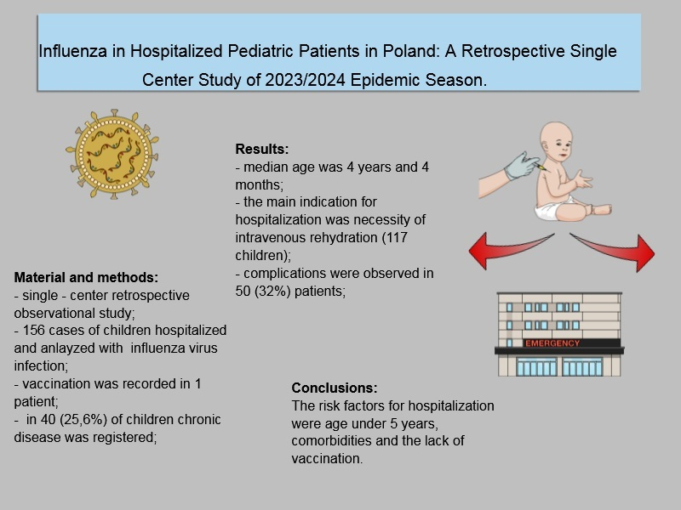

Influenza in hospitalized pediatric patients in Poland: a retrospective single-center study of the 2023/2024 epidemic season
DOI: 10.5114/aoms/203513
Arch Med Sci 2025;21(2):706-709
Notes:
Introduction
Material and methods
Results
Conclusions

