Slide 1
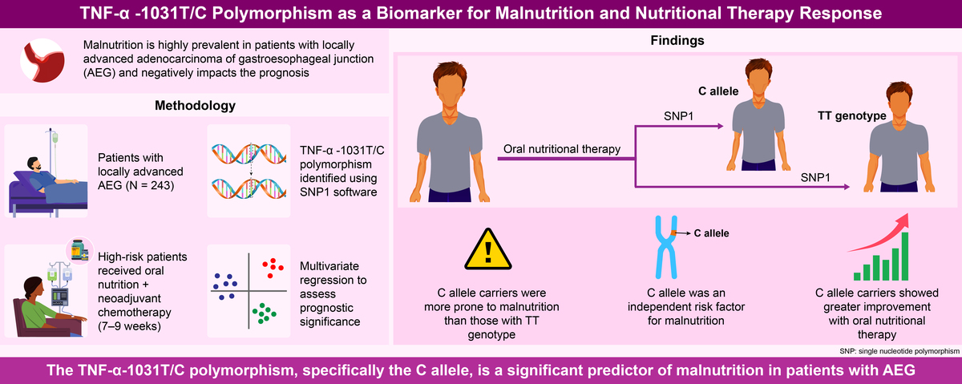

Predictive value of the -1031T/C polymorphism in the tumor necrosis factor-α gene for malnutrition prediction in patients with adenocarcinoma of the esophagogastric junction
DOI: 10.5114/aoms/203619
Notes:
Introduction
The prevalence of malnutrition in patients with locally advanced adenocarcinoma of the gastroesophageal junction (AEG) is remarkably high, and it significantly influences the prognosis beyond treatment outcomes and postoperative complications. This study aimed to investigate the potential of TNF-α-1031 T/C gene polymorphism as a predictive biomarker for malnutrition in AEG patients, as well as its efficacy in predicting oral nutritional therapy.
Material and methods
The study included 243 patients with locally advanced AEG. DNA genotyping analysis using SNP1 software was conducted on the tailoring DNA. Patients identified as high risk for malnutrition prior to treatment received concurrent oral nutritional therapy alongside neoadjuvant chemotherapy over a period of 7–9 weeks.
Results
Compared to patients carrying the TT genotype, those harboring the C allele exhibited a significantly higher susceptibility to developing malnutrition. Furthermore, there was a substantial increase in the susceptibility to malnutrition. Multivariate regression analysis revealed that carrying the C allele independently serves as a prognostic factor for malnutrition in AEG patients. Furthermore, our findings suggest that the C allele acts as an independent prognostic factor for improved nutritional status following oral nutritional therapy.
Conclusions
The TNF-α SNP (-1031 T/C) has been identified as an independent prognostic factor associated with malnutrition in patients with advanced AEG. Patients carrying the C allele exhibited a significantly poorer nutritional status compared to those with the TT genotype. Moreover, in the context of neoadjuvant chemotherapy combined with oral nutritional therapy, the nutritional status of C allele carriers was significantly poorer compared to that of TT genotype patients.

