Slide 1
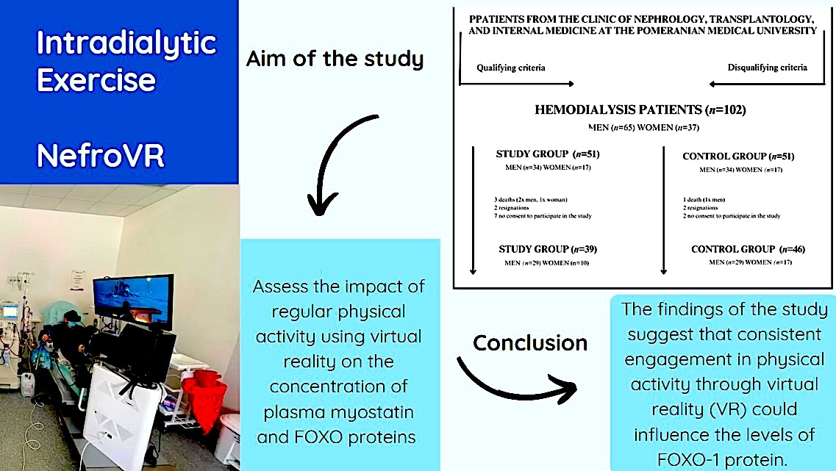

The effect of regular physical activity during hemodialysis on levels of FOXO proteins and myostatin concentration
DOI: 10.5114/aoms/203759
Arch Med Sci 2026;22(3):1653-1662
Notes:
Introduction
The implementation of virtual reality (VR) technology in the context of hemodialysis represents a groundbreaking approach that has the potential to greatly enhance patients’ motivation to engage in physical exercise. Physical exercise during hemodialysis has a positive impact on chronic inflammation, well-being, muscle mass and strength, and the risk of cardiovascular diseases. The aim of this study was to comprehensively evaluate the impact of regular physical activity using VR during hemodialysis sessions on plasma concentrations of myostatin and FOXO proteins, with particular emphasis on enhancing training attractiveness and patient motivation.
Material and methods
The study was conducted at the Department of Nephrology, Transplantology, and Internal Diseases in Szczecin (Poland). The study and the control groups consisted of end-stage renal disease patients who underwent hemodialysis as a renal replacement treatment. The study group was tasked with engaging in training sessions using the NefroVR system prototype. In contrast, patients in the control group did not participate in any intervention. To assess the concentrations of FOXO1, FOXO2, FOXO3 and myostatin parameters, blood was collected from the subjects twice: on the day of study initiation and after 3 months.
Results
A total of 102 patients were selected for participation in the study. The study group showed lower FOXO-1 values compared to the control group at measurement 2 (p = 0.041). In the study group, a statistically significant correlation was observed between measurements 1 and 2 in the FOXO1 measurement (p = 0.045).
Conclusions
The study findings suggest that training performed 3 times a week for 3 months through VR could reduce FOXO-1 protein levels.

