Slide 1
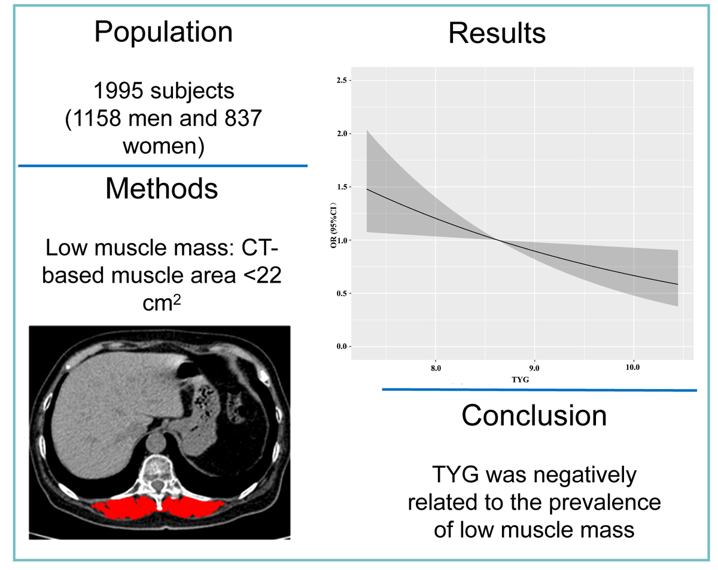

Association of the triglyceride glucose index with
computed tomography-based low muscle mass
DOI: 10.5114/aoms/203760
Notes:
Introduction
Recent studies have increasingly highlighted the connections between sarcopenia and insulin resistance. The triglyceride glucose (TYG) index has emerged as a promising surrogate marker for insulin resistance; however, its relationship with sarcopenia remains underexplored, and existing findings are inconsistent. This investigation examined this relationship in a Chinese cohort.
Material and methods
The study group comprised individuals aged 50 years or older who underwent computed tomography scans for lung cancer screening. The cross-sectional area of erector spinae was utilized as a marker of muscle mass, with a threshold of 22 cm² indicating low muscle mass. Participants were categorized into four subgroups based on quartiles of the TYG index. Logistic regression models were employed to determine the relationship between TYG and low muscle mass.
Results
Among the study cohort, 504 cases of low muscle mass were identified. The prevalence of low muscle mass showed a downward trend as the TYG increased (p = 0.023). The TYG index exhibited a positive correlation with muscle area ( = 0.98, 95% confidence interval (CI): 0.43–1.54). Higher TYG index values were linked to a reduced probability of low muscle area (odds ratio (OR) = 0.74, 95% CI: 0.59–0.95). The OR for low muscle area in the highest quartile compared to the lowest quartile was 0.61 (95% CI: 0.42–0.91). The restricted cubic spline curve corroborated these findings, indicating a consistent trend.
Conclusions
Our findings demonstrated an inverse relationship between the TYG index and the probability of low muscle mass among older adults in the Chinese population.

