Slide 1
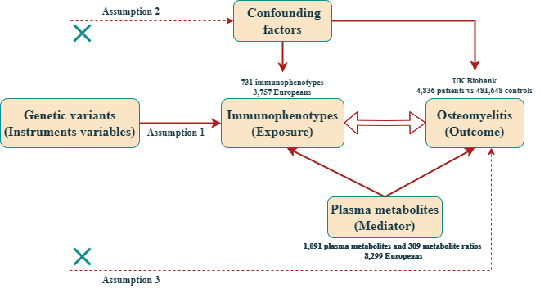

Effect of immune cells and plasma metabolites on osteomyelitis: a two-sample Mendelian randomization and mediation analysis
DOI: 10.5114/aoms/203761
Notes:
Introduction
Osteomyelitis (OM) is an infectious bone disease characterized by complex immune and metabolic features. Previous studies have found that immune cells play an important role in the development and progression of OM. However, the causal relationship between immune cells, plasma metabolites, and OM remains undetermined.
Material and methods
Instrumental variables (IVs) for 1400 plasma metabolite features (N = 7,824) and 731 immunophenotypes (N = 3,757) were sourced from genome-wide association studies (GWAS). The IVs for OM were derived from a comprehensive GWAS meta-analysis dataset of European ancestry. The relationship between exposure and outcome was assessed using two-sample Mendelian randomization (MR) analysis. The robustness of the results was evaluated through heterogeneity tests, sensitivity analyses, and pleiotropy analyses. Additionally, mediation analysis was employed to identify pathways through which immune characteristics and metabolites mediate OM.
Results
MR analysis revealed a genetic causal relationship between three immunophenotypes and nine plasma metabolites with OM. Reverse MR was used to identify the directionality of the causal relationship between CD27 on switched memory B cells, CD127 on CD8+ T cells, and OM. Lastly, mediation analysis confirmed that three plasma metabolites have a significant mediating effect on the association between two immune phenotypes and OM.
Conclusions
Through MR analysis, this study demonstrated that plasma metabolites can mediate the causal effects of immune phenotypes on OM, providing new insights into the development mechanisms of OM and potential biomarkers, which hold promising value for the clinical diagnosis and treatment of OM.

