Slide 1
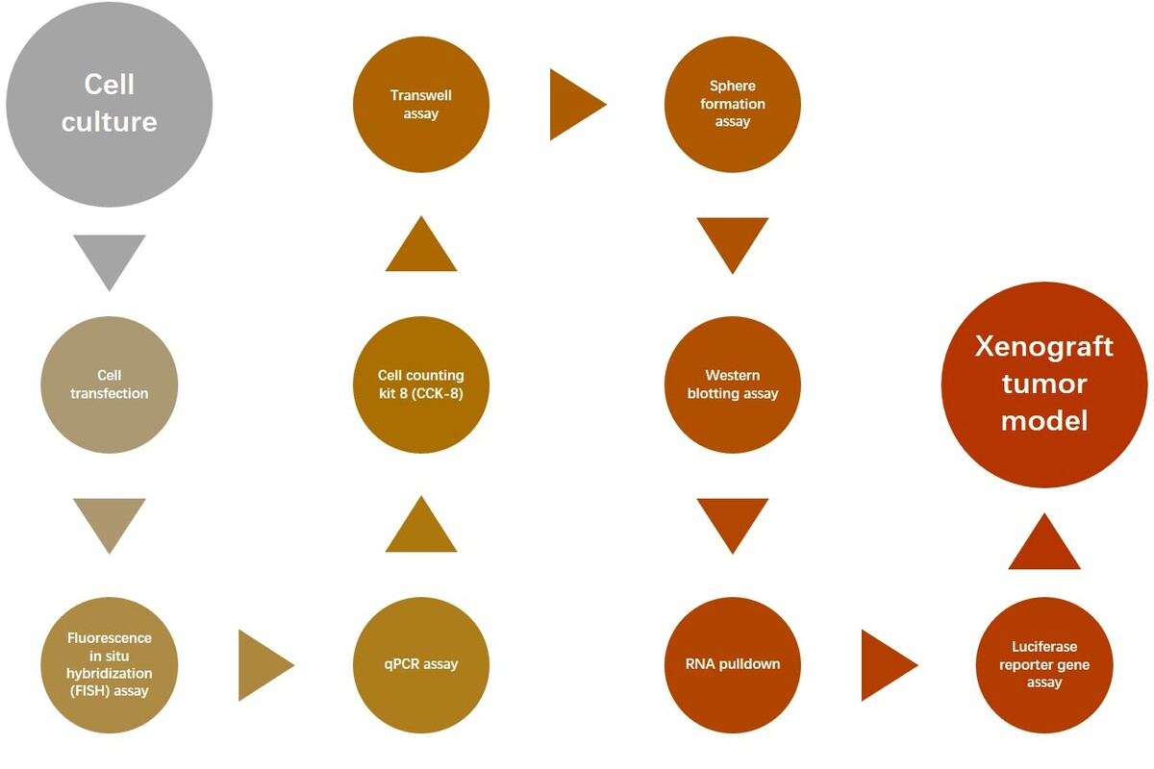

CircRNA_103809/miR-516a/FBXL18 contributes to stemness and gemcitabine resistance of bladder cancer cells
DOI: 10.5114/aoms/203762
Arch Med Sci 2025;21(6):2766-2782
Notes:
Introduction
Bladder cancer is a highly recurrent malignancy and frequently shows drug resistance. Although gemcitabine initially works well for most patients, the majority of treated patients progressively generate resistance after multiple rounds of therapy, eventually leading to tumor recurrence. Recent studies suggest that a small subpopulation of cancer cells with stem cell-like properties – cancer stem cells – may be responsible for chemoresistance and tumor recurrence. Circular RNAs (circRNAs) are novel non-coding RNAs with great potential as cancer therapy.
Material and methods
The levels of circRNA_103809 in bladder cancer cells and a normal urothelial cell line were measured by quantitative polymerase chain reaction (qPCR). Bladder cancer cells were depleted of circRNA_103809, then in vitro and in vivo cell growth, migration, invasion, sphere formation ability, and resistance to gemcitabine were analyzed. The biomarkers of cell migration, invasion, and stemness were detected by western blotting assay. The interaction between miR-516a with circRNA_103809 or FBXL18 3UTR was detected by luciferase reporter gene assay and an RNA pulldown experiment.
Results
Depletion of circRNA_103809 significantly suppressed the viability of bladder cancer cells, reduced cell migration and invasion, increased sensitivity to gemcitabine, and repressed cancer cell stemness. Further investigation of the molecular mechanism revealed that circRNA_103809 interacted with miR-516a to modulate the expression of FBXL18 in bladder cancer cells.
Conclusions
CircRNA_103809 acts as a potential promoter of bladder cancer through sponging miR-516a to upregulate FBXL18. Our findings identify circRNA_103809 as a potential target for bladder cancer therapy.

