Slide 1
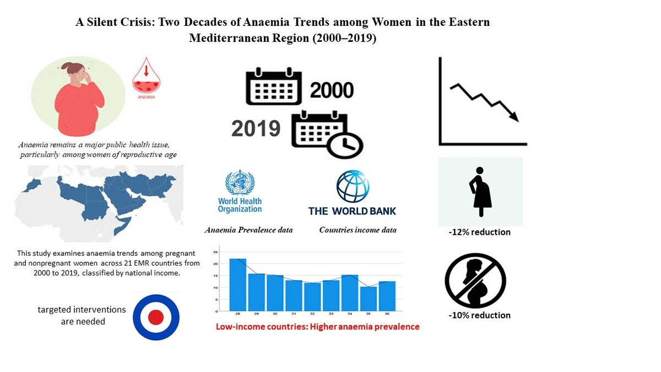

A silent crisis: two decades of anaemia trends among women in the Eastern Mediterranean Region (2000–2019)
DOI: 10.5114/aoms/203989
Arch Med Sci 2025;21(6):2426-2440
Notes:
Introduction
Anaemia remains a major public health issue. This condition adversely impacts women of reproductive age, especially in low-income countries. Although there is an ongoing global effort to reduce anaemia prevalence, progress is slow and uneven. Anaemia exhibits unique patterns in the Eastern Mediterranean Region (EMR) due to this region’s economic disparities and variations in access to health services. This study examined trends in anaemia prevalence among pregnant and nonpregnant women in the EMR by national income.
Material and methods
This retrospective cross-sectional study examined anaemia prevalence among pregnant and nonpregnant women in 21 EMR countries in the period 2000–2019 at 5-year intervals. The data on anaemia prevalence were compiled by the World Health Organization (WHO), while the World Bank provided the income classifications. Descriptive statistics were used to examine trends in prevalence and their associations with each country’s income.
Results
Although a general decrease in anaemia prevalence was observed among both pregnant and nonpregnant women, this improvement varied by income group. Pregnant women exhibited a greater reduction than nonpregnant women (–12% vs. –10%). Low-income countries reported higher prevalence rates. The study revealed significant negative associations between national income and anaemia prevalence (p < 0.001). While some countries demonstrated improvements, others exhibited unique or unexpected behaviours or stagnant rates.
Conclusions
Economic differences significantly impact trends in anaemia prevalence among women of reproductive age in the EMR. Urgent, country-targeted interventions, particularly in low-income countries, are necessary to meet the WHO’s goal of reducing anaemia among women of reproductive age by 50% before 2030.

