Slide 1
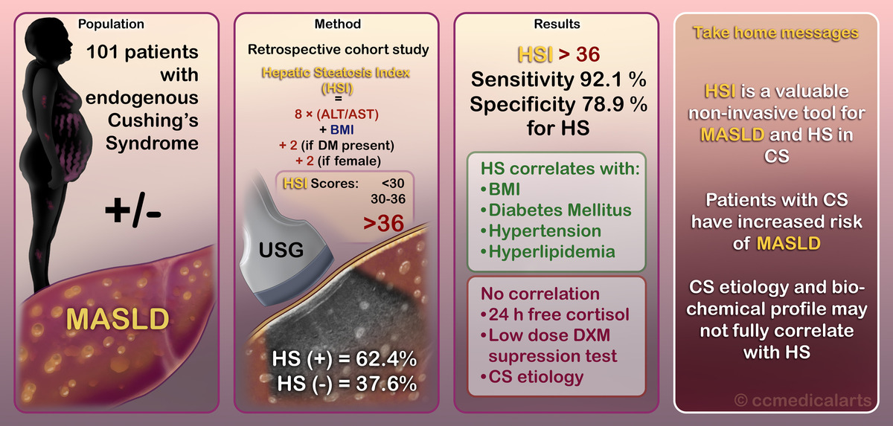

Assessing hepatosteatosis in endogenous Cushing’s syndrome: the hepatic steatosis index as a reliable diagnostic tool
DOI: 10.5114/aoms/204182
Arch Med Sci 2026;22(2):796-803
Notes:
Introduction
Non-alcoholic fatty liver disease, now termed metabolic dysfunction-associated steatotic liver disease (MASLD), represents a significant health burden worldwide. Patients with Cushing’s syndrome (CS), a condition characterized by excessive cortisol production, may be at an elevated risk for MASLD due to associated metabolic disturbances.
Material and methods
This study aimed to evaluate the predictive value of the hepatic steatosis index (HSI) in diagnosing MASLD in patients with CS. 101 endogenous CS patients were included, and hepatosteatosis was assessed using ultrasonography. HSI scores were calculated, and associations with clinical and biochemical parameters were analyzed.
Results
Hepatosteatosis was observed in 62.4% of CS patients, with all these individuals meeting the criteria for MASLD. The HSI demonstrated hepatosteatosis with high sensitivity (92.1%) and specificity (78.9%) compared to ultrasonography. Factors significantly correlated with hepatosteatosis included higher body mass index, diabetes, hypertension, and hyperlipidemia. There was no correlation with basal morning cortisol, 24-hour urinary free cortisol, low-dose dexamethasone suppression tests, or the etiology of CS.
Conclusions
Our study represents a pioneering effort to explore MASLD in patients with endogenous CS by evaluating the HSI as a diagnostic tool. Using the HSI, we demonstrated high sensitivity and specificity in diagnosing hepatosteatosis, emphasizing its potential as a valuable non-invasive tool in this population. Furthermore, our study fills a significant gap in the literature by being the first to investigate the predictive power of HSI for MASLD diagnosis, specifically in CS patients. Integrating these findings into clinical practice could enhance the early detection and management of MASLD in endogenous CS, ultimately improving patient outcomes.

