Slide 1
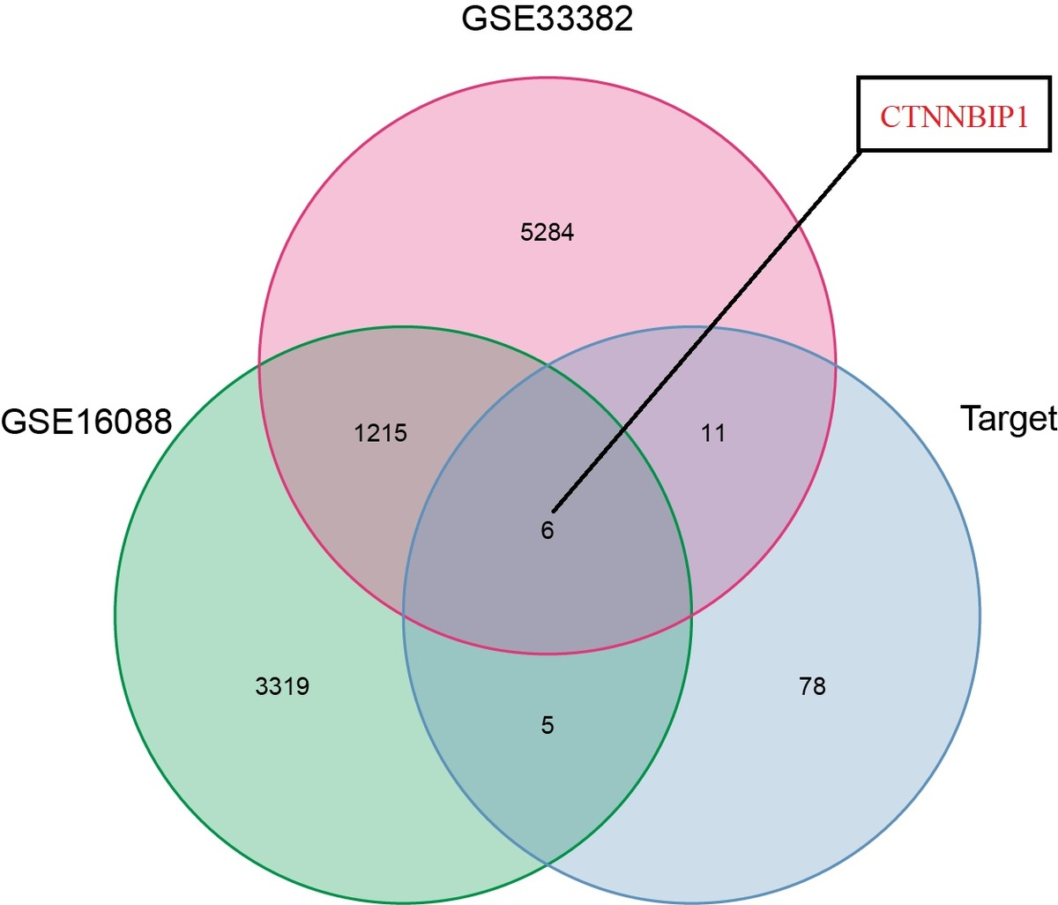

From expression to immune responses: exploring the multifaceted roles of CTNNBIP1 in osteosarcoma
DOI: 10.5114/aoms/204183
Notes:
Introduction
The CTNNBIP1 gene has been reported to be involved in development, tumorigenesis, tissue differentiation, and other processes. However, the definite roles of CTNNBIP1 in osteosarcoma remained unclear. Therefore, this study was conducted to explore the roles of CTNNBIP1 in osteosarcoma.
Material and methods
All data for bioinformatics analysis were acquired from GEO and TARGET osteosarcoma datasets. Survival analysis, expression analysis, Cox regression analyses, nomogram, gene set enrichment analysis (GSEA), and immune evaluations were performed sequentially. Experiments of qRT-PCR, western blot and immunohistochemistry were used to verify the expression of CTNNBIP1 in osteosarcoma.
Results
The expression of CTNNBIP1 was higher in osteosarcoma than in normal tissues, and further in vitro and in vivo experimental results of qRT-PCR, western blot, and immunohistochemistry remained consistent (all p < 0.05). Both univariate and multivariate Cox regression analyses revealed that disease metastasis status at diagnosis and CTNNBIP1 were independent predictors of OS in osteosarcoma (both p < 0.05). GSEA results indicated that CTNNBIP1 was significantly enriched in three pathways, including B cell receptor and nitrogen metabolism pathways, in osteosarcoma. As for the immunologic roles of CTNNBIP1 in osteosarcoma, CTNNBIP1 was found to be markedly associated with infiltration levels of naïve B cells and resting mast cells and tumor microenvironment (all p < 0.05). Furthermore, the TIDE algorithm indicated that osteosarcoma patients with elevated CTNNBIP1 expression have a better immune response to immunotherapy.
Conclusions
Our study indicated for the first time that CTNNBIP1 may serve as a potential biomarker of prognosis and immunotherapy for osteosarcoma.

