Slide 1
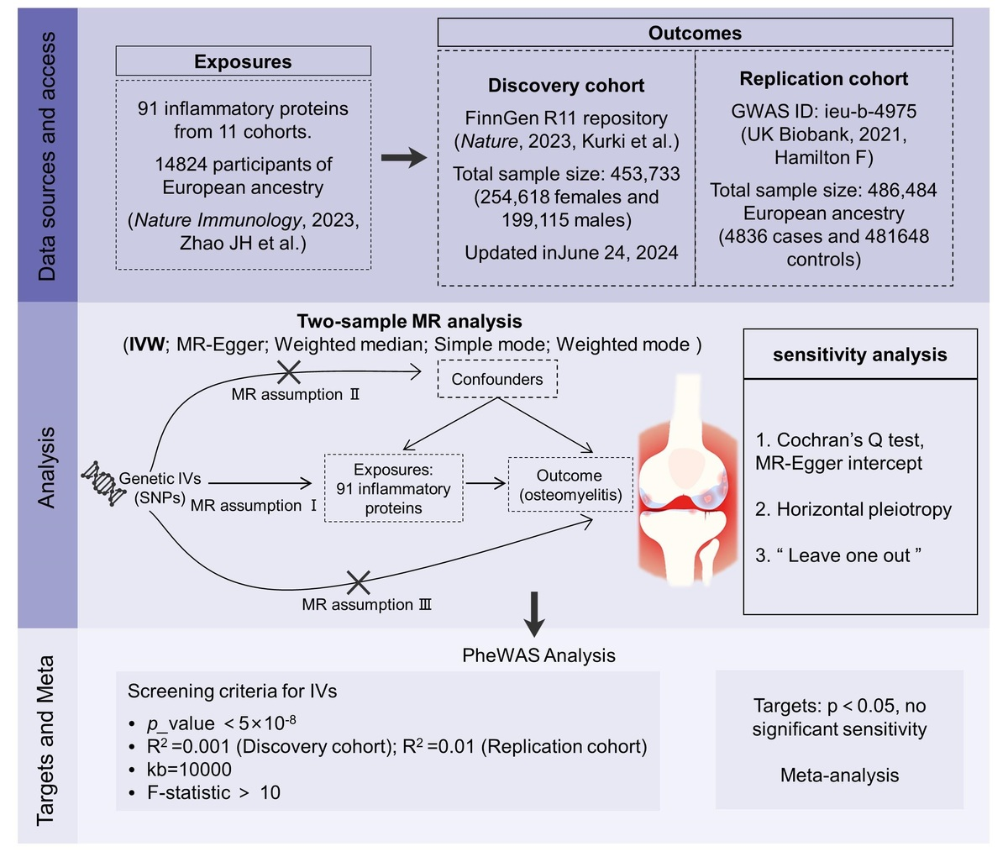

Causal relationship between 91 circulating inflammatory proteins and osteomyelitis risk: evidence from a Mendelian randomization study
DOI: 10.5114/aoms/204184
Arch Med Sci 2026;22(3):1838-1848
Notes:
Introduction
Recent research on bone immunology highlights the role of circulating inflammatory proteins in the progression of osteomyelitis (OM). We aimed to investigate the causal relationship between circulating inflammatory protein levels and OM.
Material and methods
We used summary statistics of 91 inflammatory cytokines (<i>n</i> = 14,824) to perform Mendelian randomization (MR) with two different cohorts of OM. In the discovery phase, summary statistics of OM were obtained from the FinnGen R11 database (2,125 cases vs. 429,826 controls), and the results were replicated in a larger cohort of OM from the UK Biobank study (4,836 cases vs. 481,648 controls). The results of the two MR analyses were applied to a random effects model for meta-analysis. The inverse variance-weighted (IVW) method was used as the main method for MR analysis. We conducted a series of sensitivity analyses to confirm the stability of the causal effect, and used phenotype-wide association analysis (PheWAS) to examine the potential pleiotropy in the study.
Results
Genetic evidence suggests a causal association between CCL4 (OR<sub>IVW</sub> = 1.11, 95% CI = 1.04–1.19) and OM in different European ancestry meta-analysis results, which was confirmed by robustness in sensitivity tests and PheWAS. Additionally, osteoprotegerin, MCP-4, ADA, IL15RA, and artemin were positively associated with the risk of OM, while MCP-3, C-X-C motif chemokine 5, and C-C motif chemokine 19 were negatively associated.
Conclusions
Our findings suggest a potential causal association between 9 inflammatory proteins and OM. However, this study is based on a European ancestry cohort. Future studies are needed to validate these associations in multi-ethnic cohorts and elucidate the biological mechanisms through experimental studies.

