Slide 1
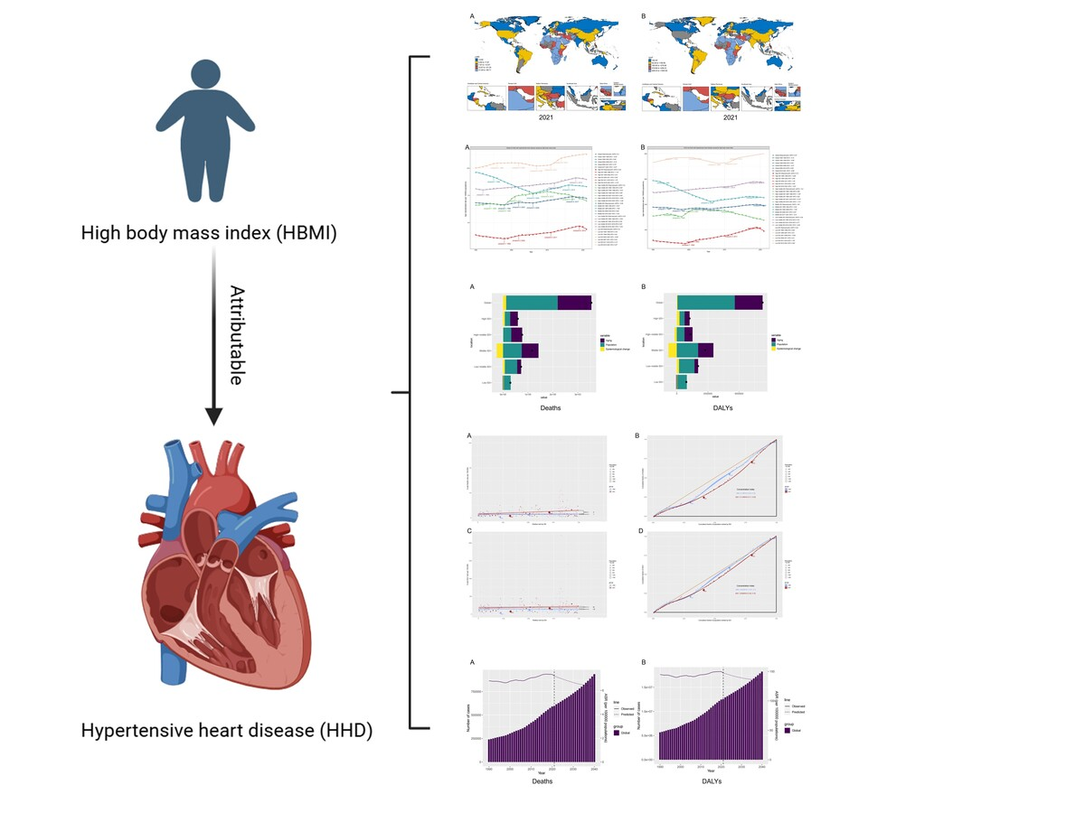

Hypertensive heart disease mortality trends attributable to high body mass index over the period 1990–2021 and projections up to 2040
DOI: 10.5114/aoms/204185
Arch Med Sci 2025;21(4):1164-1176
Notes:
Introduction
Hypertensive heart disease (HHD) has emerged as a significant global public health concern, with the increasing prevalence of high body mass index (HBMI) contributing to its growing burden. This study aimed to evaluate trends in HHD mortality attributable to HBMI from 1990 to 2021 and projections up to 2040.
Material and methods
Data on HHD mortality attributable to HBMI were obtained from the Global Burden of Diseases (GBD) 2021 database. Temporal trends in the burden of HHD attributable to HBMI were analyzed using generalized linear models to calculate the estimated annual percentage change (EAPC) in age-standardized mortality rates (ASMR) and age-standardized disability-adjusted life-year (DALY) rates (ASDR) from 1990 to 2021. A linked-point regression model, based on a linear statistical framework, was employed to evaluate these trends. Additionally, the burden of HHD attributable to HBMI was further analyzed by disaggregating contributions from population size, age structure, and epidemiologic changes. Cross-national inequalities in this burden were quantified using standard health equity methodologies recommended by the World Health Organization (WHO). Finally, changes in the burden of HHD attributable to HBMI were projected to 2040.
Results
From 1990 to 2021, the global ASMR for HHD attributable to HBMI increased from 6.83 to 7.21, with an EAPC value of 0.33 for the ASMR. ASDR increased from 144.72 to 147.33, with an EAPC value of 0.15 for ASDR. Particularly severe ASMR and ASDR were observed in most countries in Africa and in a few countries along the Mediterranean coast. In contrast, most developed countries in North America, Europe, and Australia presented lower ASMR and ASDR. When the overall trend was divided into subsections, at the end of the study period, ASMR and ASDR for HHD attributable to HBMI showed a downward trend. By dividing the regions by sociodemographic index (SDI), middle SDI had the greatest fluctuation in ASMR and ASDR, and low SDI showed an increasing trend in ASMR and ASDR at the final joinpoint. Decomposition analyses found that population growth and aging were the main factors driving changes in the burden of death due to HHD attributable to HBMI. Cross-country inequality analyses showed that high SDI countries bear a disproportionate share of the burden of deaths due to HHD attributable to HBMI and that SDI-related inequality has increased over time. Global trends in ASMR and ASDR for HHD attributable to HBMI are projected to show gradual and moderate increases from 2022 to 2040, but the number of deaths and DALYs will continue to increase.
Conclusions
From 1990 to 2021, the burden of HHD attributable to HBMI increased globally, with developing countries and low SDI regions bearing a relatively large burden of disease. Furthermore, this burden is expected to continue to increase until 2040. Therefore, more targeted prevention approaches should be established to mitigate this growing trend.

