Slide 1
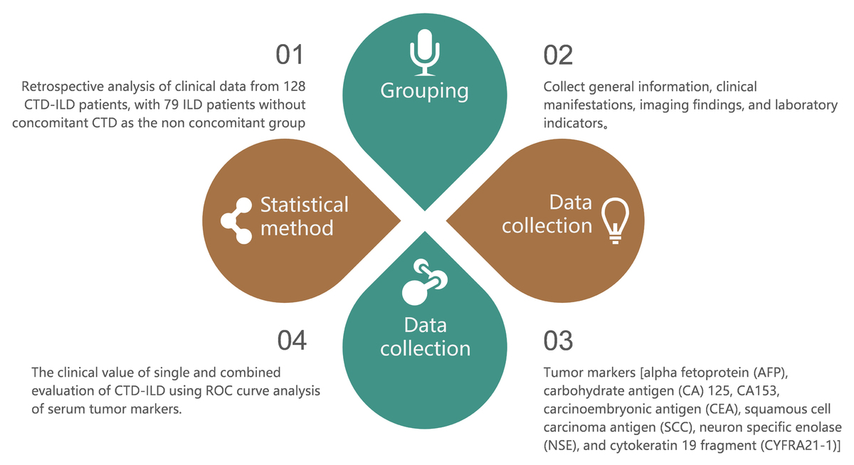

Relationship between clinical characteristics and serum tumor markers in connective tissue disease with interstitial lung disease as the initial manifestation
DOI: 10.5114/aoms/204199
Arch Med Sci 2026;22(1):155-162
Notes:
Introduction
Interstitial lung disease (ILD) is a common complication of connective tissue disease (CTD), which seriously affects the prognosis of patients. The abnormal expression of tumor markers in non-neoplastic diseases may be related to the occurrence and development of CTD-ILD. This study aimed to explore the detailed clinical characteristics of CTD-ILD, and to analyze their association with serum tumor markers.
Material and methods
The clinical data of 128 patients with CTD-ILD were retrospectively analyzed. Seventy-nine ILD patients without CTD were enrolled as the non-combined group. Clinical data included imaging manifestations, laboratory indices and tumor markers such as carbohydrate antigen (CA) 125, CA153, carcinoembryonic antigen (CEA), neuron-specific enolase (NSE), and squamous cell carcinoma (SCC) antigen were collected. ROC curve analysis was used to assess the clinical value of these markers.
Results
The proportion of clinical manifestations such as arthralgia, rash, Raynaud’s phenomenon, dry mouth and dry eyes in the combined group was higher than in the non-combined group (p < 0.05). The serum albumin and total protein levels in the combined group were lower than in the non-combined group (p < 0.001). The levels of CA125, CA153, CEA, SCC, and NSE in the combined group were higher than in the non-combined group (p < 0.001). The AUC of combined detection of each index was 0.917, with a sensitivity of 97.47% and a specificity of 76.56%.
Conclusions
The main clinical manifestations for CTD-ILD patients were arthralgia, rash, Raynaud’s phenomenon, and dry mouth and eyes. The combined detection of tumor markers had high evaluation value.

