Slide 1
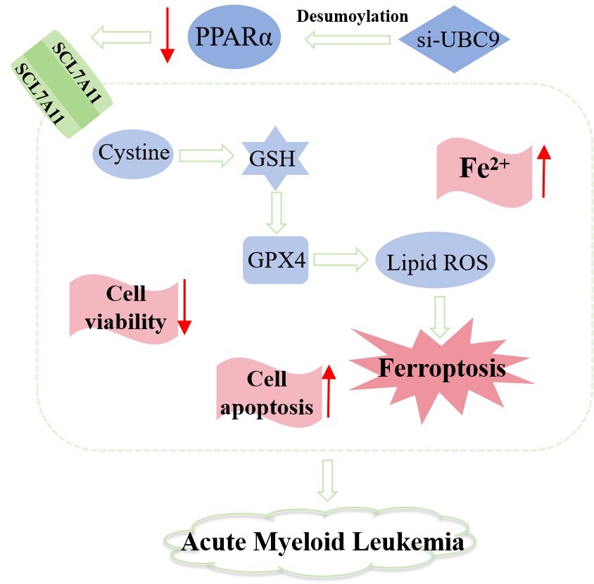

UBC9 silencing-mediated PPARa deSUMOylation induces inhibition of cell proliferation by ferroptosis in acute myeloid leukemia
DOI: 10.5114/aoms/204235
Arch Med Sci 2026;22(2):1074-1083
Notes:
Introduction
Inhibited acute myeloid leukemia (AML) proliferation is accompanied by downregulated peroxisome proliferator-activated receptor a (PPARa), which however can be stabilized via SUMOylation. This study investigated how PPARa SUMOylation impacts AML cell growth.
Material and methods
Human AML HL-60 and Tohoku Hospital Pediatrics-1 (THP-1) cells were treated with the PPARa inhibitor GW6471 (10 µM) for 24 and 48 h. THP-1 cells were exposed to the PPARa agonist pirinixic acid (10 µM) following manipulation of the expression of the small ubiquitin-like modifier protein (SUMO)-conjugating enzyme UBC9. The interaction between PPARa and SUMO1 was detected by immunoprecipitation assay. HL-60 and THP-1 cell viability, apoptosis, and ferroptosis were measured via Cell Counting Kit-8 assay, flow cytometry, BODIPY-C11 staining and/or colorimetric assay. UBC9, glutathione peroxidase 4 (GPX4), recombinant solute carrier family 7, member 11(SLC7A11) and PPARa expression levels were analyzed by qRT-PCR or Western blot.
Results
GW6471 treatment for 24 and 48 h suppressed viability, promoted apoptosis and lipid peroxidation, increased the level of Fe<sup>2+</sup>, and decreased the expression of GPX4, SLC7A11 and PPARa in HL-60/THP-1 cells. PPARa antibody induced enrichment of PPARa and SUMO1 in THP-1 cells, which was attenuated after UBC9 silencing. UBC9 silencing resulted in viability decrease, apoptosis and lipid peroxidation promotion, Fe<sup>2+</sup> upregulation, and GPX4, SLC7A11, and PPARa downregulation in THP-1 cells, which were all counteracted by pirinixic acid.
Conclusions
UBC9 silencing-induced PPARa deSUMOylation induces suppression of AML cell growth by ferroptosis.

