Slide 1
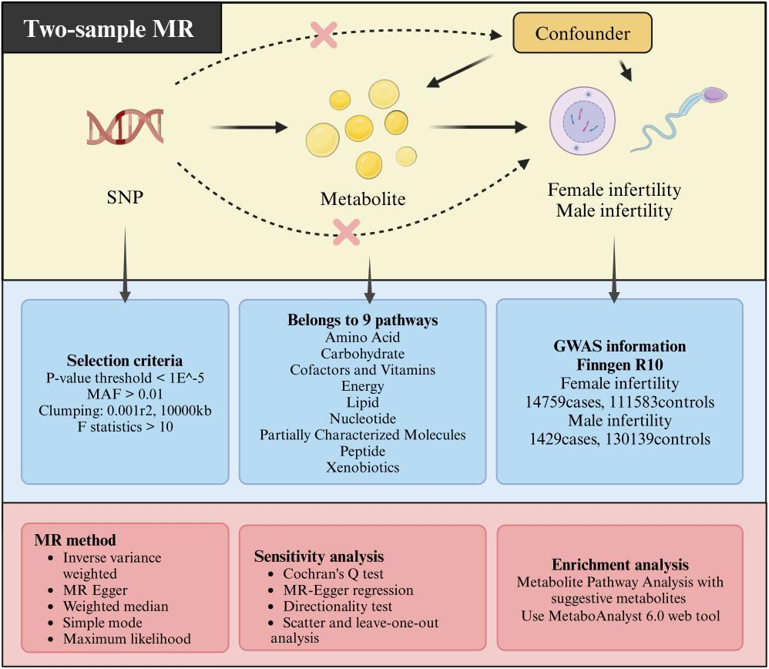

Genetic causal associations between serum metabolites and infertility: a Mendelian randomization study
DOI: 10.5114/aoms/204248
Arch Med Sci 2026;22(3):1794-1803
Notes:
Introduction
This study aimed to elucidate the causal relationships between serum metabolites and infertility in both men and women, and to identify key metabolic biomarkers.
Material and methods
This study employed a two-sample Mendelian randomization design, with circulating plasma metabolite genome-wide association study data as an exposure factor and FinnGen Consortium R10 genome-wide association study data for infertility in men and women as an outcome. The causal relation between plasma metabolites and infertility in men and women was assessed using five methods: inverse variance weighted, Egger regression, weighted median, maximum likelihood estimation, and simple mode.
Results
This analysis identified 17 and 10 metabolites positively and negatively associated with infertility in women, respectively. Similarly, 22 and 30 metabolites were positively and negatively associated with infertility in men, respectively. Galactonate and glycerate levels were identified as risk factors for infertility in both men and women. In addition, sphingomyelin exerts protective effects against infertility in both men and women. Metabolic pathway analysis revealed enrichment of critical metabolic pathways related to infertility.
Conclusions
This study identified several circulating metabolic biomarkers associated with infertility. These biomarkers can be used for the screening and prevention of infertility. In addition, they could be employed as candidate molecules for future mechanistic exploration and drug-targeting studies.

