Slide 1
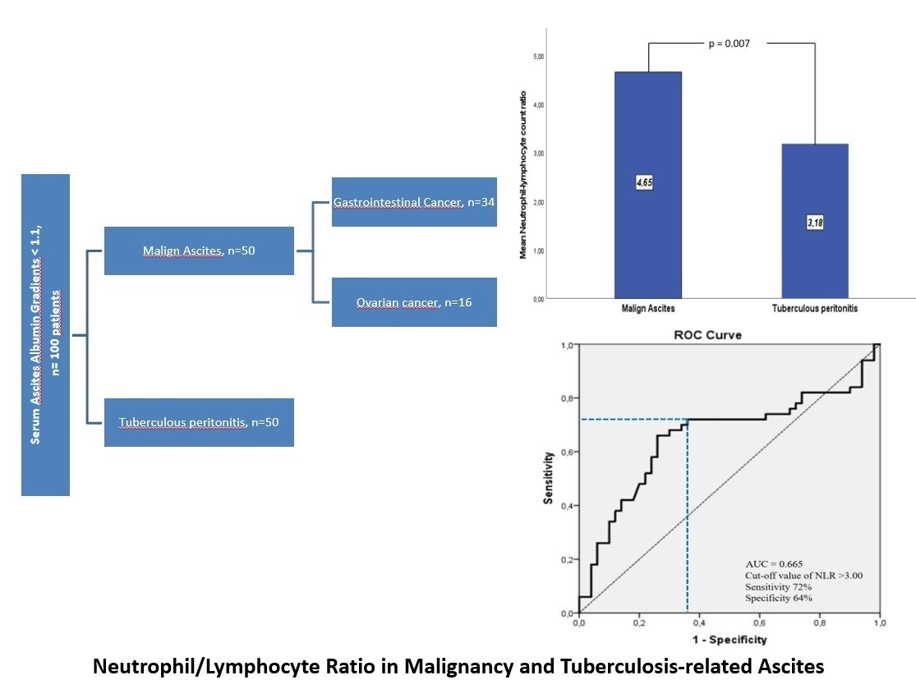

Is the neutrophil/lymphocyte ratio a useful index in the differential diagnosis of malignancy and tuberculosis-related ascites?
DOI: 10.5114/aoms/204328
Arch Med Sci 2026;22(3):1596-1602
Notes:
Introduction
Distinguishing between malignant ascites (MA) and ascites secondary to tuberculous peritonitis (TBpA) can sometimes be challenging for the clinician. The neutrophil-to-lymphocyte ratio (NLR) has been shown to be a useful index of advanced disease and poor prognosis in patients with cancer. We investigated the suitability of the neutrophil-lymphocyte ratio, an inflammatory biomarker, in differentiating MA and TBpA.
Material and methods
Demographic and laboratory characteristics of 100 patients with confirmed diagnoses of malignant ascites and ascites secondary to tuberculous peritonitis between January 2015 and December 2020 were analyzed retrospectively. The diagnostic ability of NLR in differential diagnosis was evaluated.
Results
Serum neutrophil-lymphocyte ratio was significantly higher in patients with MA than in patients with TBpA (4.65 ±3.17 vs. 3.17 ±1.74, p = 0.007). The area under the curve value was 0.655 (95% confidence interval = 0.544–0.767, p = 0.007). The optimal threshold value for distinguishing malignant ascites from TBpA was determined to be NLR > 3.00 (sensitivity 72.0%, specificity 64.0%, positive predictive value 66.7%, negative predictive value 69.6%, accuracy 68%). This threshold value was found to have better discrimination rates in the patient group over 40 years of age (sensitivity 70.0%, specificity 88.0%, positive predictive value 85.4%, negative predictive value 74.6%, accuracy 79.0%).
Conclusions
NLR, a simple and rapid inflammatory index, can be among the initial diagnostic tests to distinguish MA and TBpA, especially in those older than 40 years.

