Slide 1
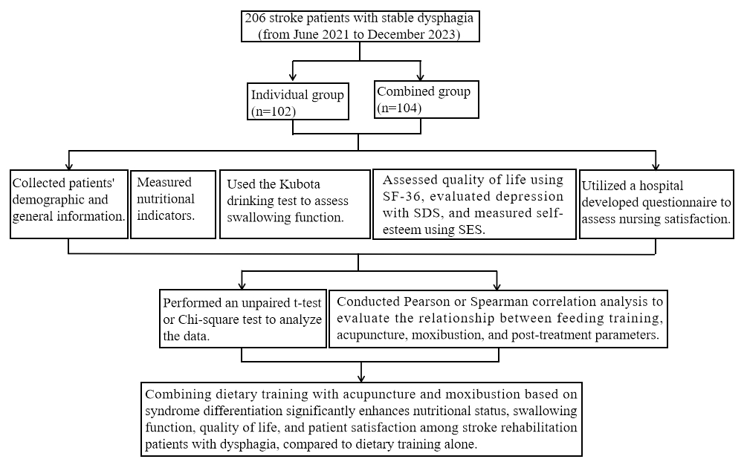

Application of dietary training combined with acupuncture based on syndrome differentiation for treating dysphagia in stroke rehabilitation patients
DOI: 10.5114/aoms/204368
Arch Med Sci 2026;22(3):1420-1432
Notes:
Introduction
Stroke-induced dysphagia significantly impacts patients’ nutritional status, quality of life, and rehabilitation outcomes. Conventional therapy primarily involves dietary training, while acupuncture and moxibustion have been used in complementary medicine. This study aims to evaluate the efficacy of combining dietary training with acupuncture and moxibustion based on syndrome differentiation in improving dysphagia outcomes in stroke rehabilitation patients.
Material and methods
A retrospective cohort study, conducted from June 2021 to December 2023, included 206 stroke patients (aged 40 to 80 years) with stable dysphagia. Patients were divided into two groups: an individual treatment group (n = 102) receiving standard dietary training, and a combination treatment group (n = 104) receiving dietary training with acupuncture and moxibustion. The intervention lasted 6 weeks. Nutritional status, swallowing function (evaluated via Kubota drinking test and videofluoroscopic swallowing study – VFSS), quality of life, depression, self-esteem, and patient satisfaction were assessed before and after treatment.
Results
Pre-treatment demographics and clinical characteristics showed no significant differences between groups. Post-treatment results indicated significant improvements in the combination group compared to the individual group across all parameters: nutritional status (triceps skin fold – TSF, middle arm muscle circumference on the healthy side – AMS, hemoglobin – Hb, serum albumin – ALB, serum prealbumin – PA), swallowing function (Kubota test, VFSS scores: higher in combined, p = 0.028), quality of life (SF-36 scores), depression (SDS scores: lower, p = 0.022), self-esteem (SES scores: higher, p = 0.005), and patient satisfaction (70.19% vs. 54.9%, p = 0.034). Correlation analysis confirmed the positive associations between combined treatment and outcomes (e.g., post-TSF r = 0.196, p = 0.005).
Conclusions
Combining dietary training with acupuncture and moxibustion based on syndrome differentiation significantly enhances nutritional status, swallowing function, quality of life, and patient satisfaction among stroke rehabilitation patients with dysphagia, compared to dietary training alone. This integrative approach presents a promising adjunctive therapy for post-stroke dysphagia, warranting further investigation in larger, randomized controlled trials.

