Slide 1
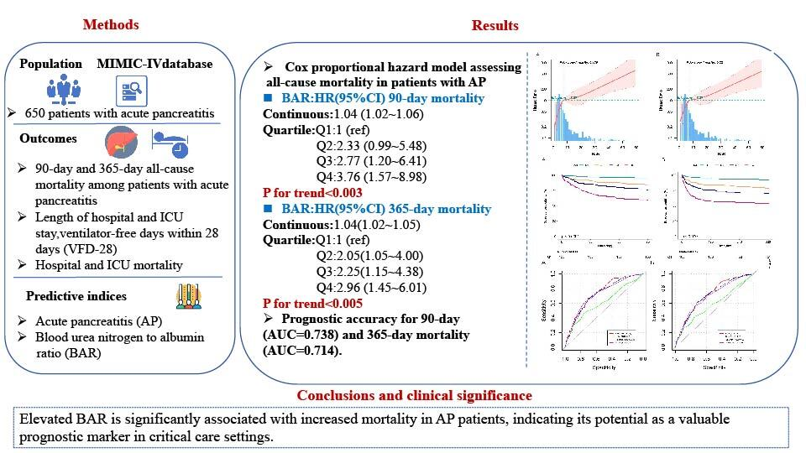

Increased blood urea nitrogen to serum albumin ratio is associated with poor prognosis in patients with acute pancreatitis: a retrospective cohort study
DOI: 10.5114/aoms/204369
Arch Med Sci 2026;22(3):1498-1509
Notes:
Introduction
The blood urea nitrogen to serum albumin ratio (BAR) may serve as a prognostic marker. This study evaluated its association with clinical outcomes in patients with acute pancreatitis (AP).
Material and methods
We performed a retrospective cohort analysis using data from the MIMIC-IV 2.2 database, including 650 patients diagnosed with AP. The primary outcomes were 90-day and 365-day mortality. Cox proportional hazards models assessed the relationship between BAR and mortality. Restricted cubic spline (RCS) analysis examined the non-linear relationship.
Results
Among the 650 patients, the mortality rates at 90 days and 365 days were 21.2% and 26.2%, respectively. Higher BAR levels correlated with increased 90-day and 365-day mortality (p < 0.001). BAR had hazard ratios (HR) of 1.04 (95% CI: 1.02–1.06) for 90-day and 1.04 (95% CI: 1.02–1.05) for 365-day mortality. ROC analysis revealed that BAR’s AUC was 0.738 for 90-day and 0.714 for 365-day mortality. Subgroup and sensitivity analyses indicated stable results across various conditions.
Conclusions
Elevated BAR is significantly associated with increased mortality in AP patients, indicating its potential as a valuable prognostic marker in critical care settings.

