Slide 1
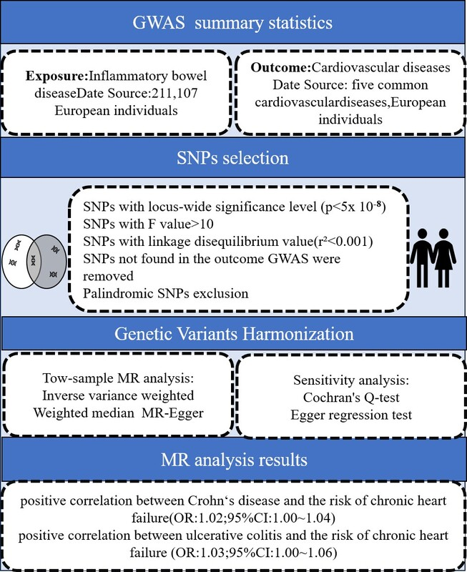

Causal relationship between inflammatory bowel disease and cardiovascular disease: a two-sample Mendelian randomized study
DOI: 10.5114/aoms/204370
Arch Med Sci 2025;21(5):1811-1820
Notes:
Introduction
Inflammatory bowel disease (IBD) includes Crohn’s disease (CD) and ulcerative colitis (UC). Epidemiological studies have found that patients with IBD are more likely to suffer from cardiovascular diseases (CVDs) than the general population. However, so far, no exact causal association has been demonstrated between IBD and CVDs, and more research is needed to clarify this relationship.
Material and methods
The two-sample Mendelian randomization (MR) method was used to explore the causal effect of IBD on CVDs. The exposure factor was IBD, including CD and UC. The outcome was CVDs, including chronic heart failure, atrial fibrillation, coronary heart disease, myocardial infarction and hypertension. The single nucleotide polymorphisms (SNPs) are all from the FinnGen genome-wide association study sample database. The CD samples included 210,300 controls and 807 cases, and the UC samples included 215,806 controls and 2701 cases. The samples included are all European samples. SNPs associated with Crohn’s disease and ulcerative colitis were extracted from the IEUGWAS database and quality control and screening were carried out. Inverse variance weighted (IVW), MR-Egger, weighted median and other methods were used to study the causal relationship between them and CVDs. Finally, Cochrane’s Q test, MR-Egger and the leave-one method were used for sensitivity analysis.
Results
In this study, 4 SNPs strongly associated with Crohn’s disease and 12 SNPs strongly associated with ulcerative colitis were screened. The IVW method of genetic prediction revealed a positive correlation between Crohn’s disease and the risk of chronic heart failure (OR =1.02; 95% CI: 1.00–1.04), and there was a positive correlation between ulcerative colitis and the risk of chronic heart failure (OR = 1.03; 95% CI:1.00–1.06). IVW, MR-Egger and weighted median showed that Crohn’s disease and ulcerative colitis were not associated with the risk of atrial fibrillation, coronary heart disease, myocardial infarction or hypertension. Sensitivity analysis showed that the results are robust.
Conclusions
Crohn’s disease and ulcerative colitis are associated with an increased risk of chronic heart failure, but they are not associated with the risk of other CVDs.

