Slide 1
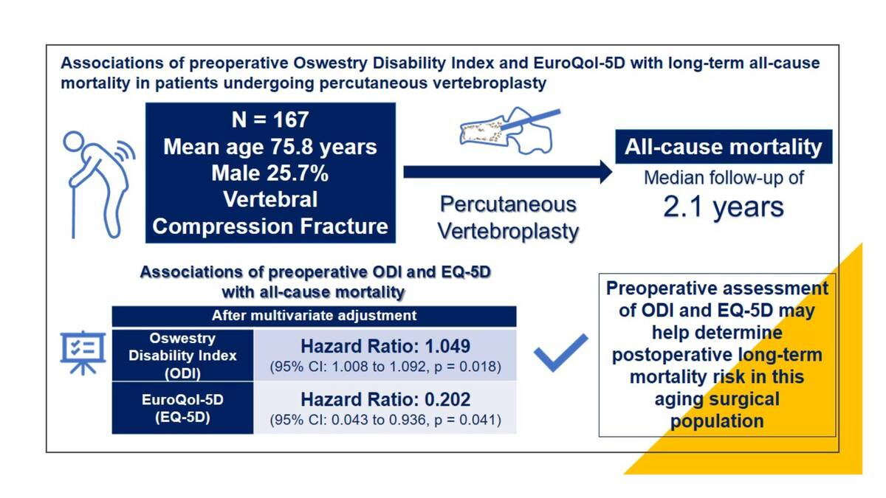

Associations of preoperative Oswestry Disability Index and EuroQol-5D with long-term all-cause mortality in patients undergoing percutaneous vertebroplasty
DOI: 10.5114/aoms/204372
Arch Med Sci 2025;21(4):1381-1387
Notes:
Introduction
Oswestry Disability Index (ODI) and EuroQol-5D (EQ-5D) have been widely used to assess general health quality and function in clinical studies of patients with vertebral fractures. We aimed to investigate the associations of preoperative ODI and EQ-5D with long-term mortality in patients undergoing percutaneous vertebroplasty.
Material and methods
We retrospectively identified adult patients who had a single-level vertebral compression fracture and received percutaneous vertebroplasty between 2013 and 2020. Patients with traumatic fractures, burst fractures, and pathologic fractures, as well as those who had missing information on preoperative assessment of ODI and EQ-5D, were excluded. Survival status of the study patients was confirmed at the end of March 2021. The associations of preoperative ODI and EQ-5D with all-cause mortality were examined using Cox-proportional hazard models.
Results
A total of 167 patients were analyzed (mean age: 75.8 ±9.3 years, 25.7% male). There were 28 patients who died during a median follow-up duration of 2.1 years (63.6 per 1000 patient-years). Preoperative ODI was significantly associated with all-cause mortality after vertebroplasty (HR = 1.049, 95% CI: 1.008 to 1.092, <i>p</i> = 0.018). In contrast, preoperative EQ-5D was independently associated with a lower risk of all-cause mortality after the surgery (HR = 0.202, 95% CI: 0.043 to 0.936, <i>p</i> = 0.041).
Conclusions
Preoperative assessment of ODI (HR = 1.049, 95% CI: 1.008 to 1.092) and EQ-5D (HR = 0.202, 95% CI: 0.043 to 0.936) may help determine postoperative long-term mortality risk in this aging surgical population.

