Slide 1
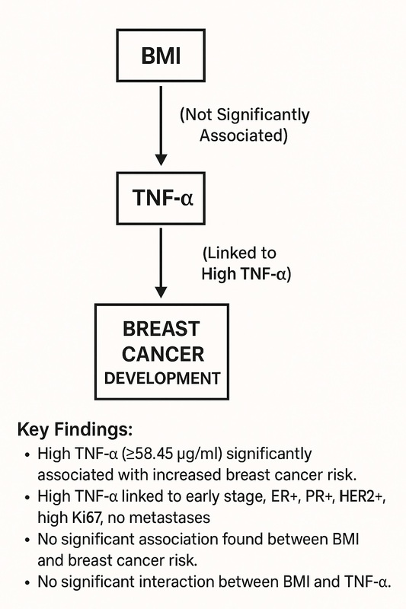

The role of body mass index and tumor necrosis factor a in breast cancer development: a case-control study
DOI: 10.5114/aoms/204415
Arch Med Sci 2026;22(3):1457-1469
Notes:
Introduction
A high body mass index (BMI) is closely associated with increased breast cancer risk. Despite the established associations of BMI and tumor necrosis factor-α (TNF-α) with breast cancer, few studies have explored their combined effects on breast cancer development. The aim of our study was to evaluate the separate and combined associations of BMI and TNF-α with breast cancer risk.
Material and methods
A case-control study was conducted involving 794 women diagnosed with breast cancer and 268 age-matched healthy controls from Sun Yat-sen University’s affiliated hospitals between October 2008 and March 2018. Data on demographic characteristics, clinical features, and TNF-α levels were collected. Logistic regression models were used to calculate odds ratios (ORs) and 95% confidence intervals (CIs) for the associations between BMI, TNF-α, and breast cancer risk.
Results
High levels of TNF-α (≥ 58.45 µg/ml) were significantly associated with an increased risk of breast cancer (OR = 1.500; 95% CI: 1.112–2.022). Elevated TNF-α levels were associated with early clinical stage, positivity for ER, PR, and HER2, high Ki67 expression, and the absence of lymphatic and distant metastases. No significant association was found between BMI and breast cancer risk (OR = 0.947; 95% CI: 0.685–1.310), nor was there a significant interaction effect between BMI and TNF-α.
Conclusions
TNF-α plays a significant role in breast cancer development, particularly in early clinical stages, and in specific pathological features. BMI alone is not a significant predictor of breast cancer risk. These findings underscore the importance of TNF-α as a potential target for breast cancer prevention and treatment strategies.

