Slide 1
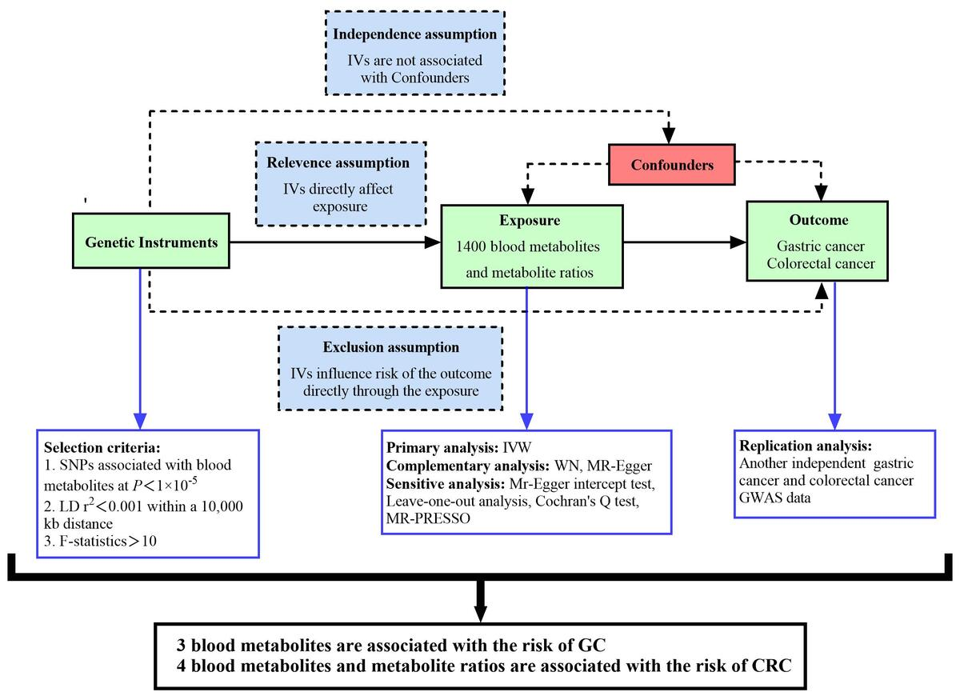

The causal effects of 1400 genetically determined human blood metabolites and metabolite ratios on the risk of gastrointestinal tumors: a Mendelian randomization study
DOI: 10.5114/aoms/204639
Arch Med Sci 2026;22(2):968-982
Notes:
Introduction
Recently, studies investigating the association between blood metabolites and gastrointestinal tumors have gained increased attention. A Mendelian randomization (MR) study is considered the second most persuasive research method to explore the causal relationship between exposure and outcome after RCT.
Material and methods
This analysis utilized the inverse variance weighted (IVW) method, the weighted median (WM) method, and MR-Egger regression. Initially, we analyzed GWAS data from the FinnGen database to identify various metabolites and their ratios. Subsequently, we repeatedly analyzed GWAS data from the Open GWAS database to filter out duplicate results.
Results
5-methyluridine (FinnGen : odds ratio (OR) = 1.16, 95% confidence interval (CI) = 1.02–1.31, <i>p</i> = 0.03, FDR-P = 0.04; Open GWAS: OR = 1.08, 95% CI = 1.01–1.17, <i>p</i> = 0.03, FDR-P = 0.04) and 1-dihomo-linolenylglycerol (FinnGen: OR = 1.30, 95% CI = 1.02–1.65, <i>p</i> = 0.03, FDR-P = 0.04; Open GWAS: OR = 1.16, 95% CI = 1.02–1.31, <i>p</i> = 0.03, FDR-P = 0.04) were positively associated with the risk of gastric cancer (GC). Sphingomyelin (FinnGen: OR = 0.73, 95% CI = 0.54–0.98, <i>p</i> = 0.04, FDR-P = 0.04; Open GWAS: OR = 0.81, 95% CI = 0.67–0.97, <i>p</i> = 0.02, FDR-P = 0.04) was negatively correlated with GC risk. Carnitine to propionylcarnitine (C3) ratio (FinnGen: OR = 1.11, 95% CI = 1.01–1.22, <i>p</i> = 0.03, FDR-P = 0.04; Open GWAS: OR = 1.07, 95% CI = 1.01–1.14, <i>p</i> = 0.04, FDR-P = 0.04), arachidonate to linoleate ratio (FinnGen: OR = 1.10, 95% CI = 1.02–1.19, <i>p</i> = 0.02, FDR-P = 0.04; Open GWAS: OR = 1.12, 95% CI = 1.06–1.18, <i>p</i> = 4.44 × 10–<sup>5</sup>, FDR-P = 3.55 × 10<sup>–4</sup>), and androsterone sulfate (FinnGen: OR = 1.07, 95% CI = 1.01–1.14, <i>p</i> = 0.03, FDR-P = 0.04; Open GWAS: OR = 1.05, 95% CI = 1.01–1.10, <i>p</i> = 0.04, FDR-P = 0.04) were positively associated with the risk of colorectal cancer (CRC). 1-oleoyl-2-docosahexaenoyl-GPC (FinnGen: OR = 0.89, 95% CI = 0.81–0.98, <i>p</i> = 0.02, FDR-P = 0.04; Open GWAS: OR = 0.93, 95% CI = 0.87–0.99, <i>p</i> = 0.02, FDR-P = 0.04) was negatively correlated with CRC risk.
Conclusions
Three blood metabolites were found to be associated with the risk of GC; 4 blood metabolites and metabolite ratios were associated with the risk of CRC. These findings may provide valuable guidance for the early clinical diagnosis and treatment of gastrointestinal tumors.

