Slide 1
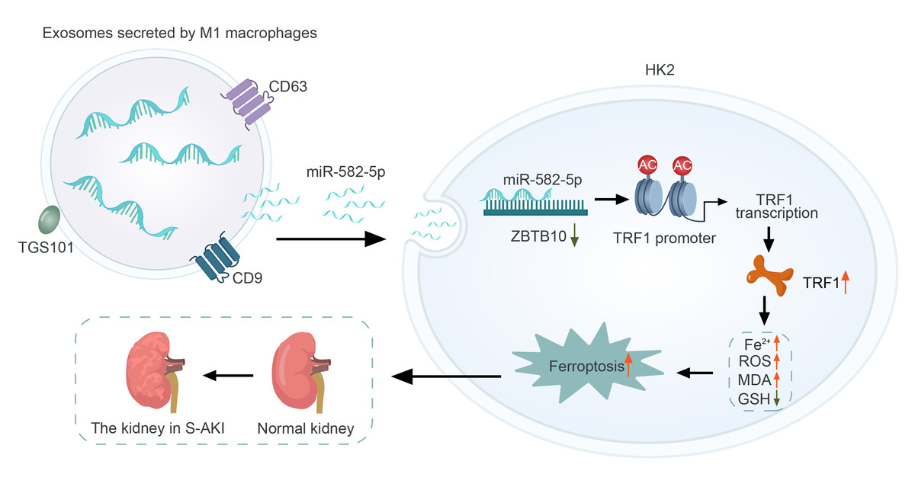

M1 macrophage exosomes induce ferroptosis via MiR-582-5p-mediated ZBTB10 suppression in sepsis-induced acute kidney injury
DOI: 10.5114/aoms/204810
Arch Med Sci 2026;22(1):408-427
Notes:
Introduction
Sepsis-induced acute kidney injury (S-AKI) poses a significant clinical challenge, necessitating effective therapeutic strategies. This study investigated the influence of M1-polarized macrophage-derived exosomes on the proliferation and ferroptosis of renal tubular epithelial cells (HK2).
Material and methods
We polarized THP-1 and RAW264.7 cells to the M1 phenotype and validated their polarization through reverse transcription-quantitative polymerase chain reaction (RT-qPCR). Exosomes isolated from these macrophages were applied to treat HK2 cells, resulting in a significant reduction in cell proliferation, as demonstrated by Cell Counting Kit-8 (CCK-8) and 5-ethynyl-2deoxyuridine (EdU) assays. Furthermore, increased malondialdehyde (MDA) and Fe2+ levels, decreased glutathione (GSH) levels, and altered mitochondrial morphology indicated enhanced ferroptosis. RT-qPCR and Western blot analyses showed upregulation of the ferroptosis-promoting gene TFR1, while other related genes remained unaffected.
Results
We identified miR-582-5p as a key exosomal miRNA significantly upregulated in HK2 cells following treatment with M1-polarized macrophage exosomes. Overexpression of miR-582-5p in HK2 cells mirrored the exosomal effects, inhibiting proliferation and promoting ferroptosis. Mechanistic studies revealed that miR-582-5p binds to the 3 untranslated region (UTR) of ZBTB10, suppressing its expression. This suppression led to increased H3K27ac modification of the TFR1 promoter, enhancing TFR1 transcription and ferroptosis.
Conclusions
These findings uncover a novel pathway by which M1 macrophage exosomes deliver miR-582-5p to induce ferroptosis in HK2 cells, highlighting potential therapeutic targets for S-AKI.

