Slide 1
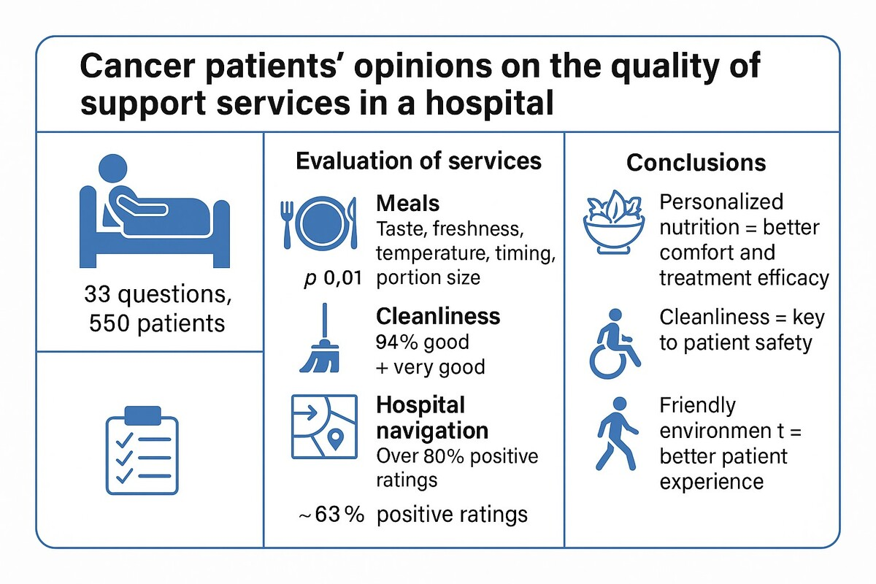

Hospital care for cancer patients: the impact of support services on the patient experience
DOI: 10.5114/aoms/205073
Arch Med Sci 2025;21(3):1080-1084
Notes:
Introduction
Material and methods
Results
Conclusions

