Slide 1
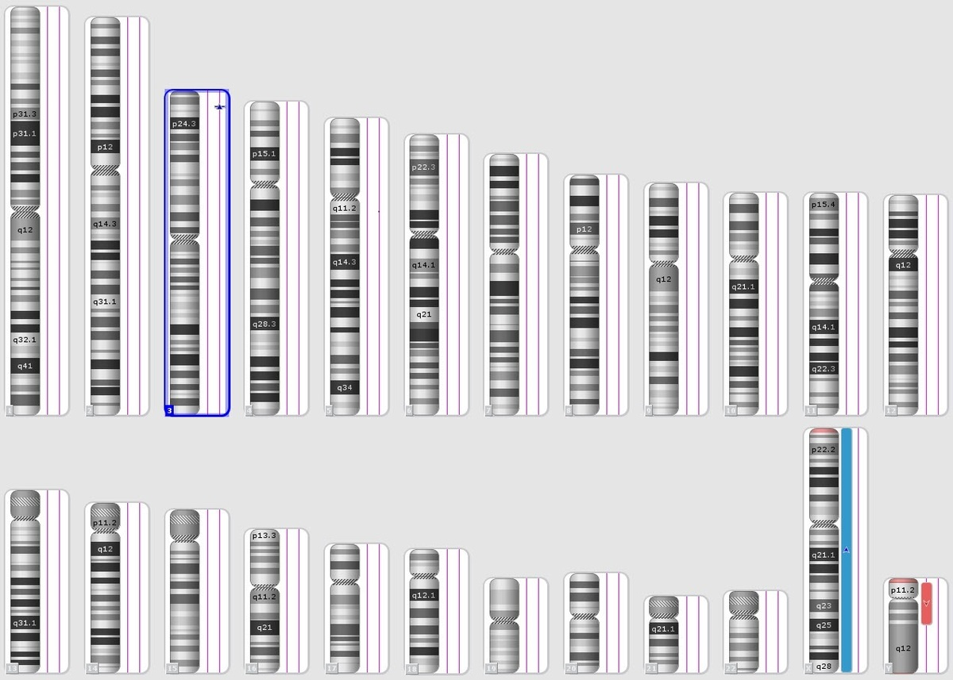

Integration of molecular diagnostics and karyotyping for enhanced detection of chromosomal abnormalities in fetuses
DOI: 10.5114/aoms/205110
Arch Med Sci 2025;21(3):1062-1068
Notes:
Introduction
Material and methods
Results
Conclusions

