Slide 1
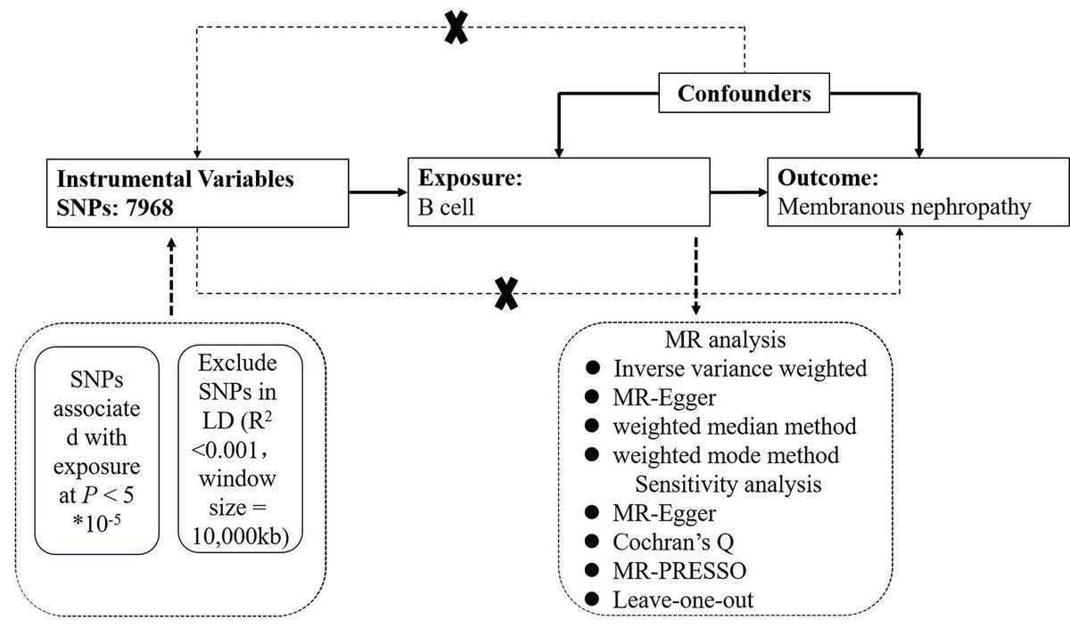

Exploring causality between peripheral blood B cell subtypes and membranous nephropathy: a two-sample Mendelian randomization study
DOI: 10.5114/aoms/205111
Arch Med Sci 2026;22(2):991-1000
Notes:
Introduction
Membranous nephropathy (MN) is a glomerular autoimmune disease associated with nephrotic syndrome. This study explored the influence of peripheral blood B cell subtypes on MN using Mendelian randomization (MR).
Material and methods
Data on single-nucleotide polymorphisms (SNPs) associated with peripheral blood B cells and MN were obtained from a genome-wide association study (GWAS). Analytical methods included instrumental variable weighted (IVW), weighted median, weighted mode methods, and MR-Egger regression. Sensitivity analyses were conducted using MR-Egger, Mendelian Randomization Pleiotropy RESidual Sum and Outlier (MR-PRESSO) for outlier detection, Cochran’s Q test for heterogeneity, and leave-one-out analysis to assess the robustness of the findings.
Results
Higher levels of IgD+ CD24-B cell absolute count (OR = 0.8285, 95% CI: 0.7317–0.9381, p = 0.003), B-cell activating factor receptor (BAFF-R) on IgD+ CD24-B cells (OR 0.9045, 95% CI: 0.8275-0.9886, p = 0.0269), BAFF-R on IgD+ CD38dim B cells (OR = 0.9057, 95% CI: 0.8277–0.991, p = 0.0311), BAFF-R on IgD- CD27-B cells (OR = 0.9134, 95% CI: 0.8404–0.9928, p = 0.0332), CD19 on IgD-CD24-B cells (OR = 0.884, 95% CI: 0.7906–0.9886, p = 0.0306), CD24 on switched memory B cells (OR = 0.8927, 95% CI: 0.8133–0.9798, p = 0.0169), and CD25 on switched memory B cells (OR = 0.8768, 95% CI: 0.7745–0.9927, p = 0.0379) were strongly associated with an decreased risk of membranous nephropathy. Sensitivity analyses were conducted to confirm the stability of the findings.
Conclusions
This MR study supports the possibility of a genetic causal association between peripheral blood B cell subtypes and MN. The results improve our understanding of the immunological basis of MN and may inform the development of personalized medicine.

